Slide 1
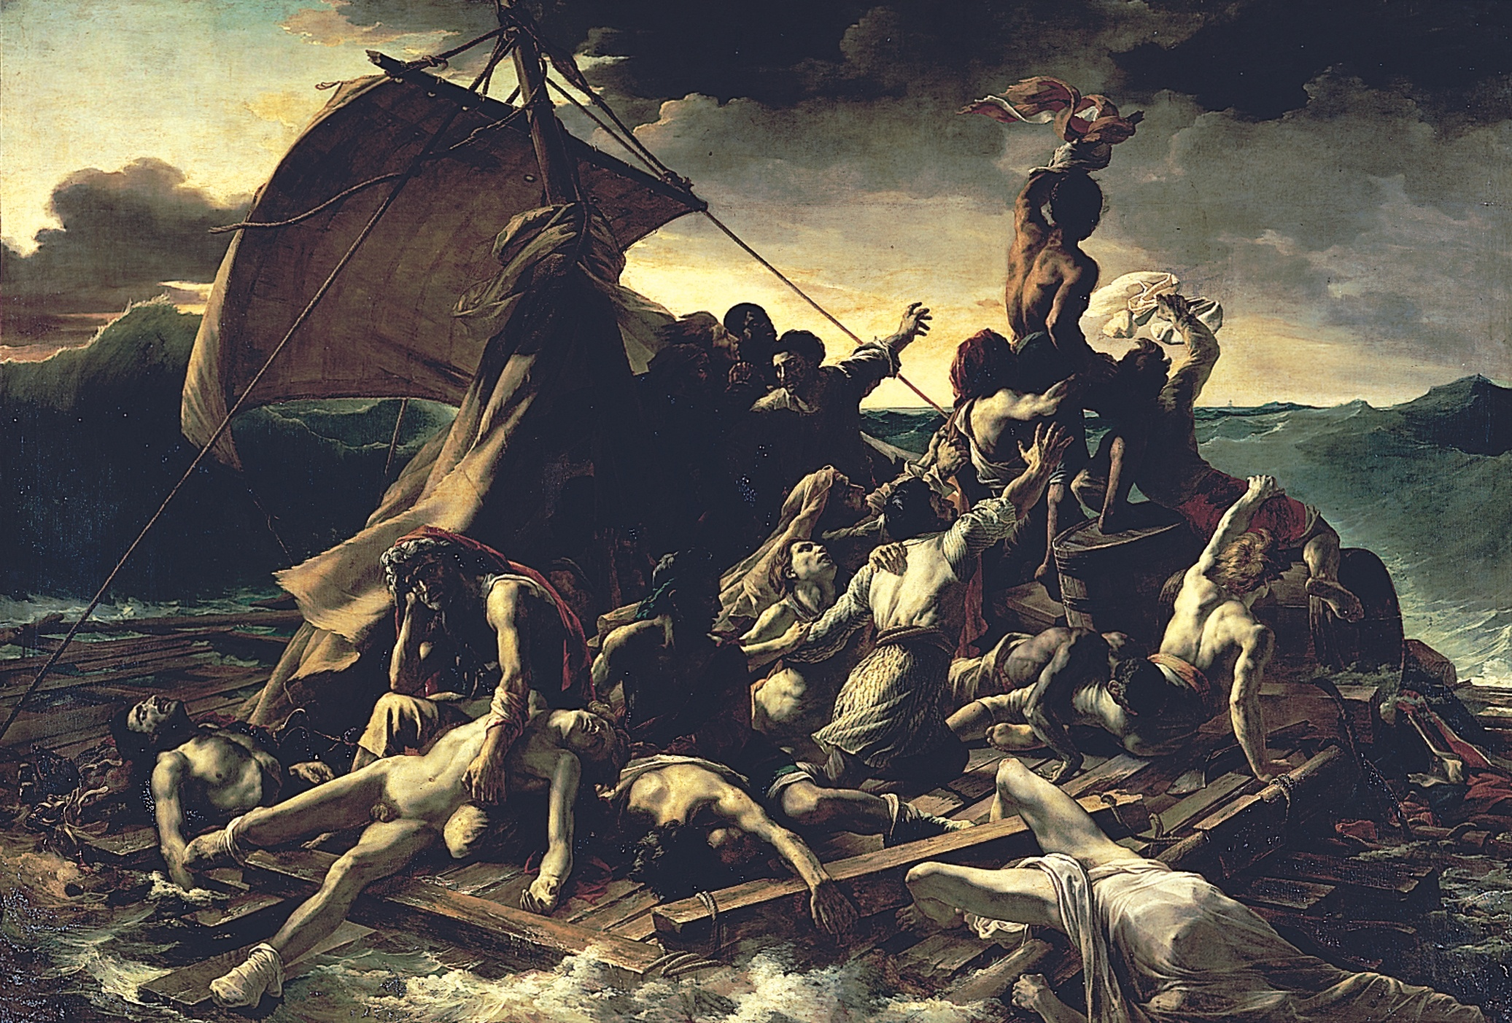
THÉODORE GÉRICAULT, Raft of the Medusa, 1818–1819. Oil on canvas, 16’ 1” x 23’ 6”. Louvre, Paris.
Notes:
<number>

Slide 2
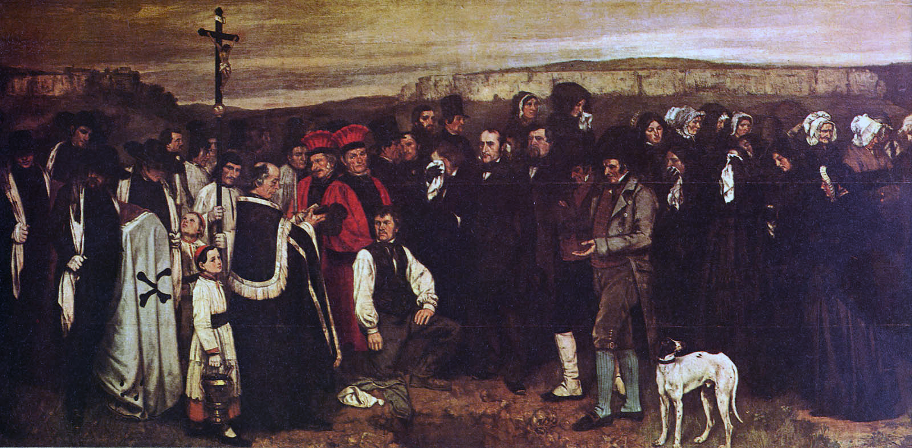
Gustave Courbet, Burial at Ornans, 1849-50

Slide 3
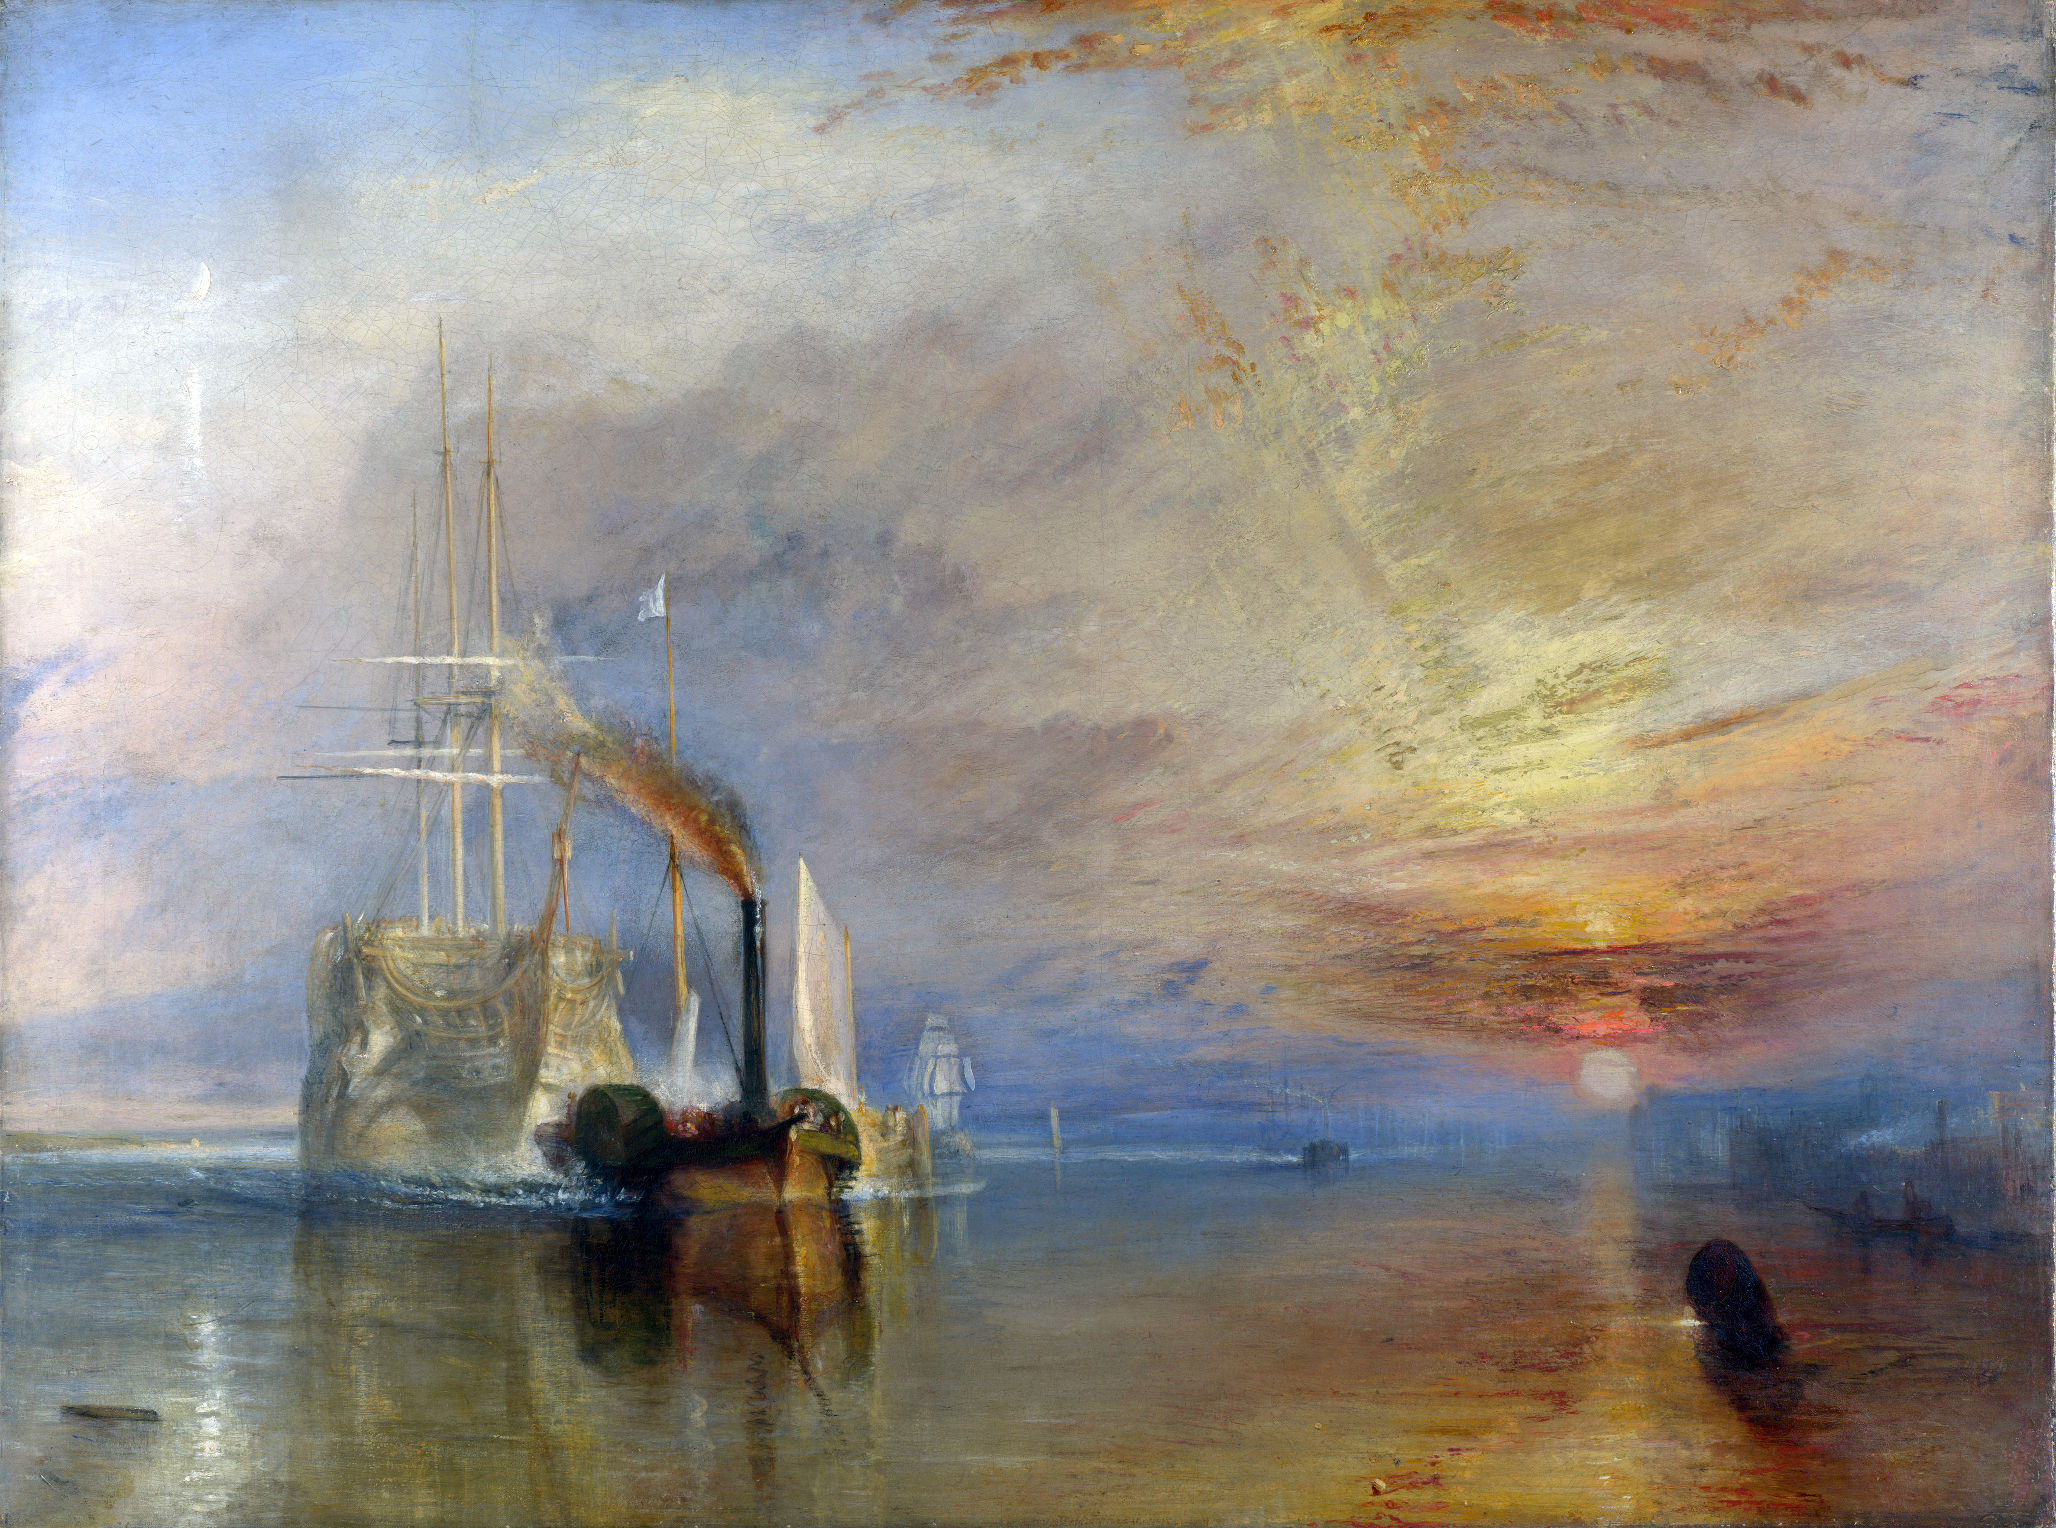
J. M. W. Turner, The Fighting Temeraire tugged to her last
Berth to be broken up, 1838, painted in 1839

Slide 4
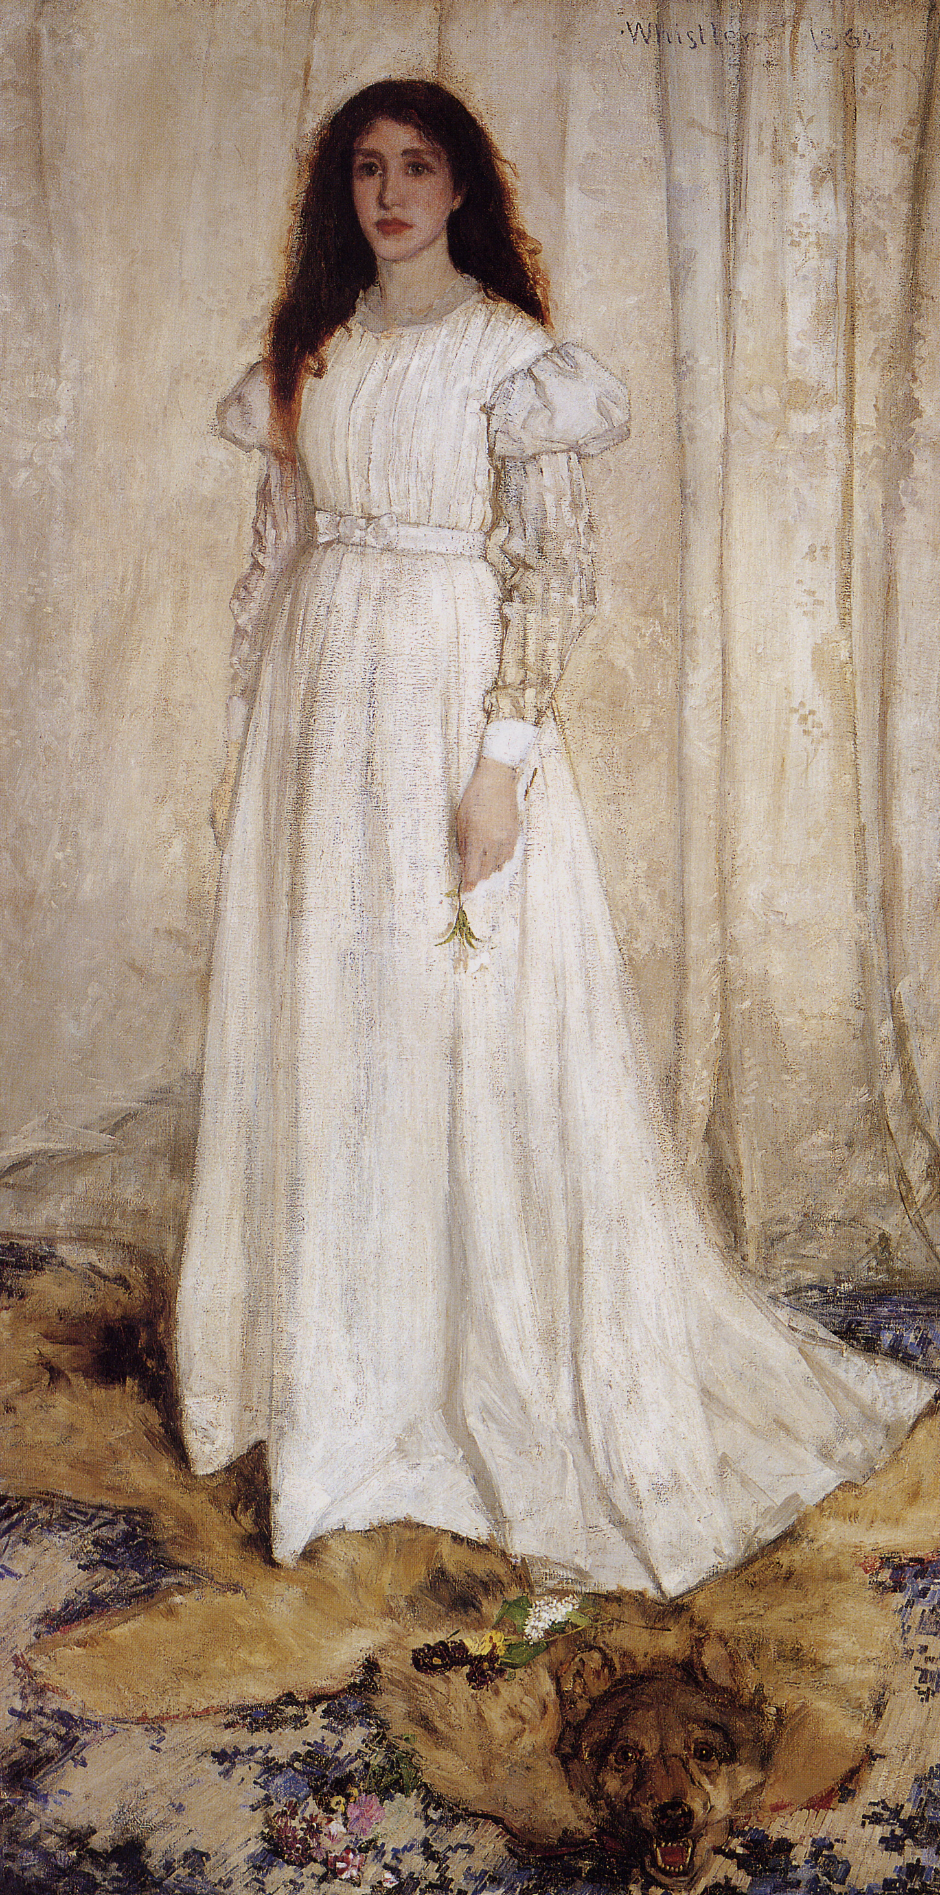
James Abbot McNeill Whistler,
Symphony in White, No. 1: The White Girl,
1861-62

Slide 5
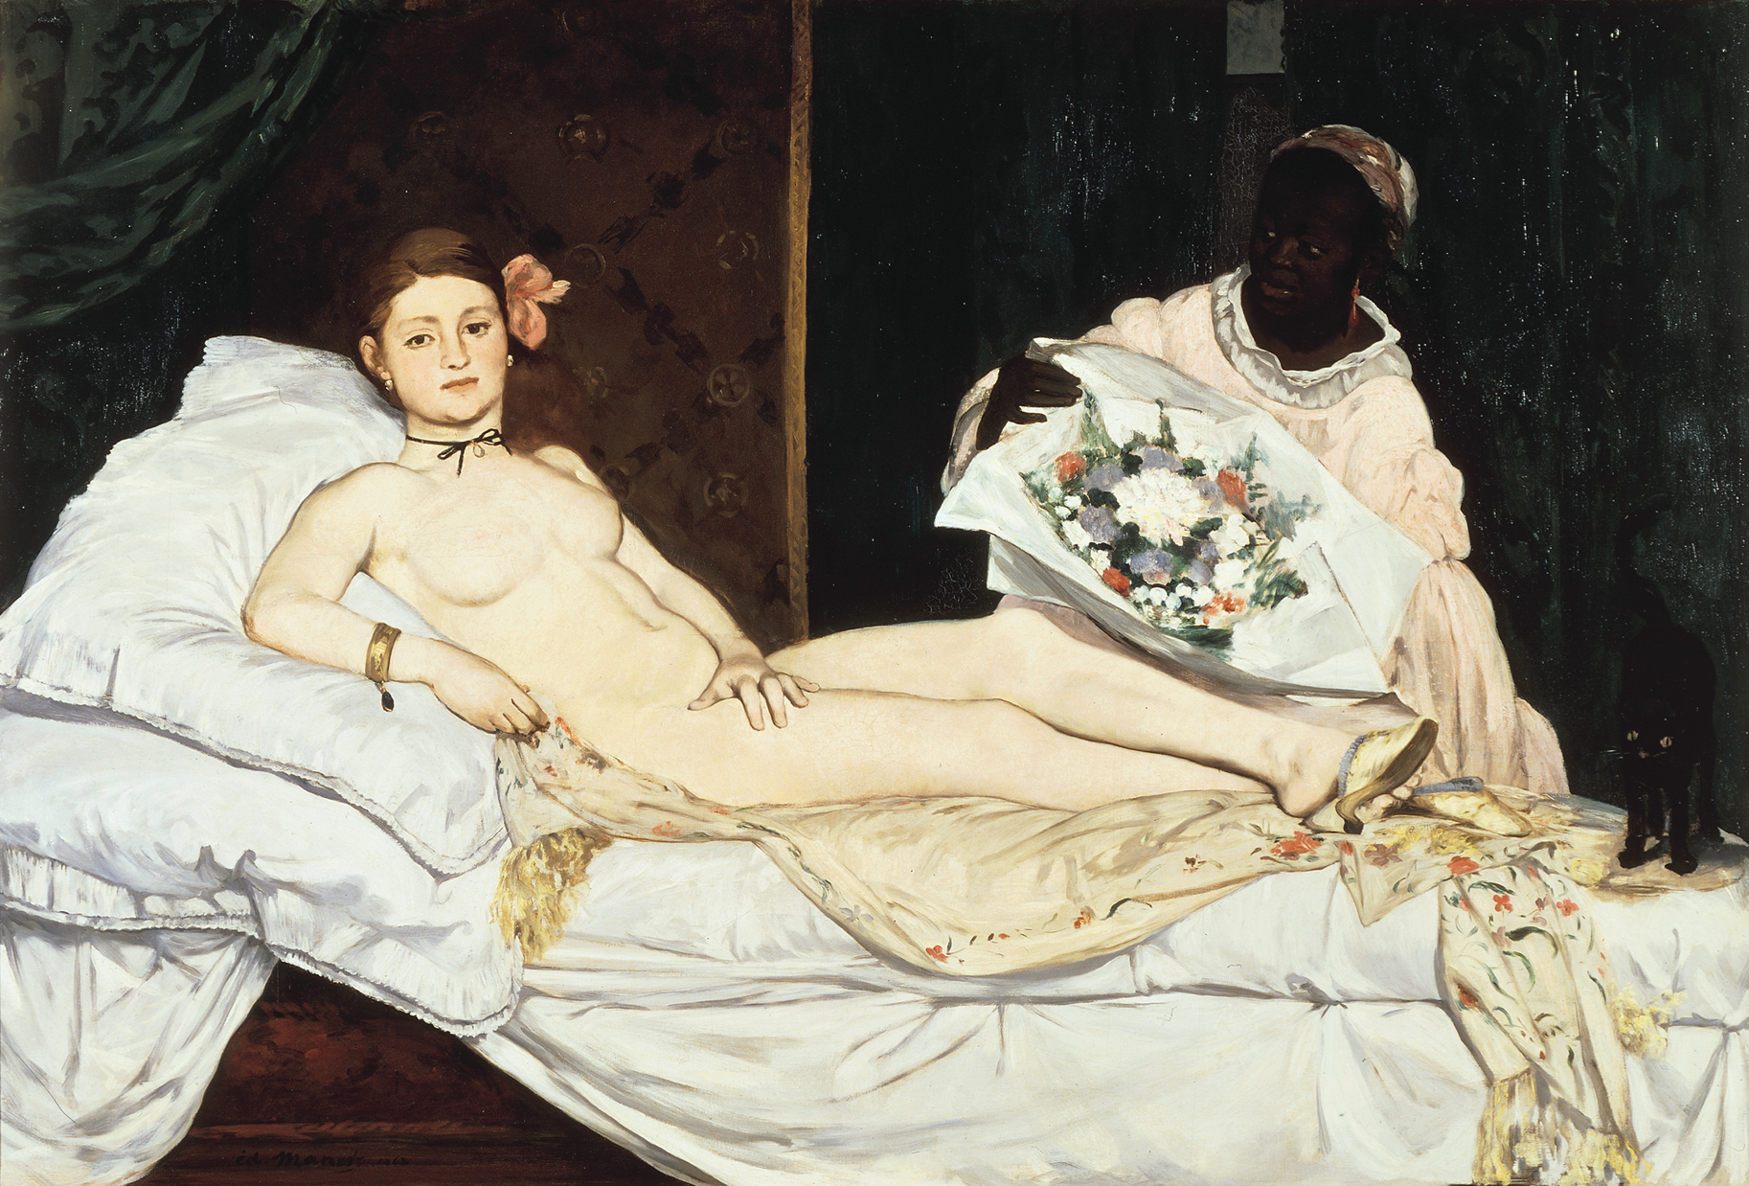
ÉDOUARD MANET, Olympia, 1863. Oil on canvas, 4’ 3” x 6’ 2 1/4”. Musée d’Orsay, Paris.
Notes:
<number>

Slide 6
Émile Zola, a French writer, quickly proclaimed it Manet's "masterpiece" and added, "When other artists correct nature by painting Venus they lie. Manet asked himself why he should lie. Why not tell the truth?" (from Wikipedia”)

Slide 7
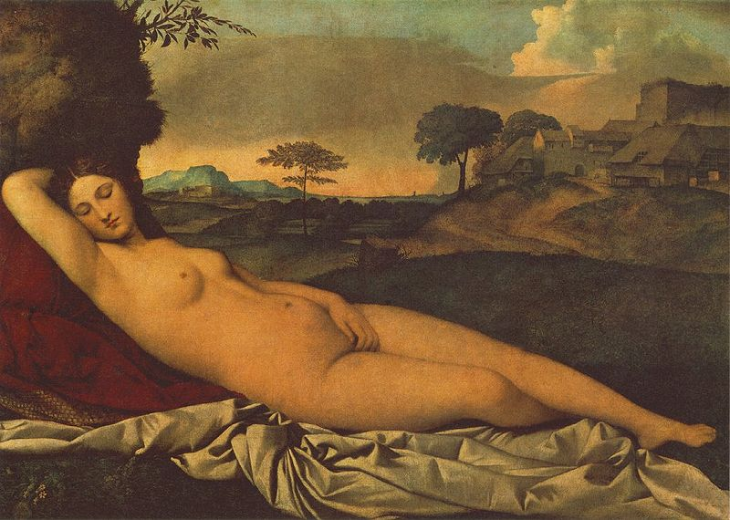
Giorgione's Sleeping Venus, c. 1510

Slide 8
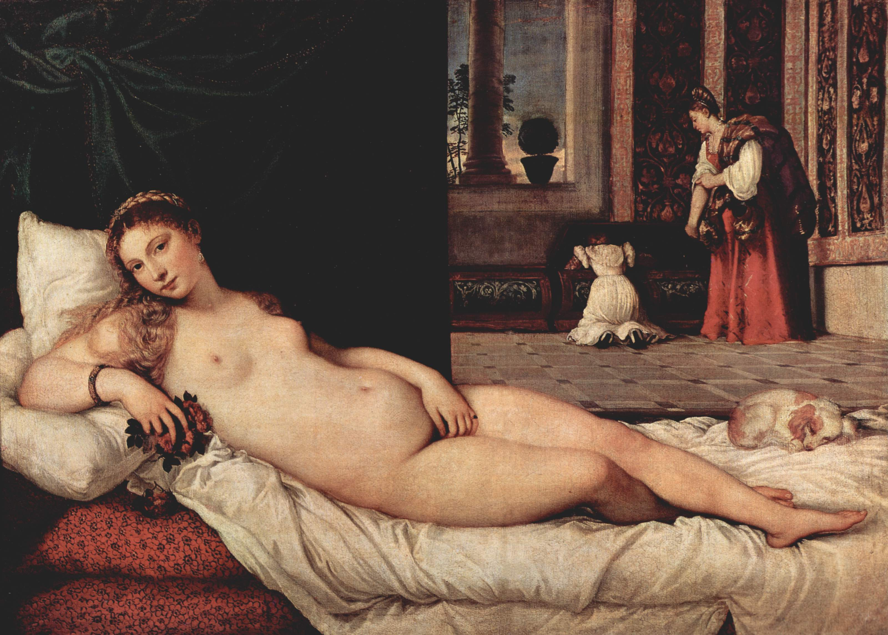
Titian's Venus of Urbino, 1538

Slide 9
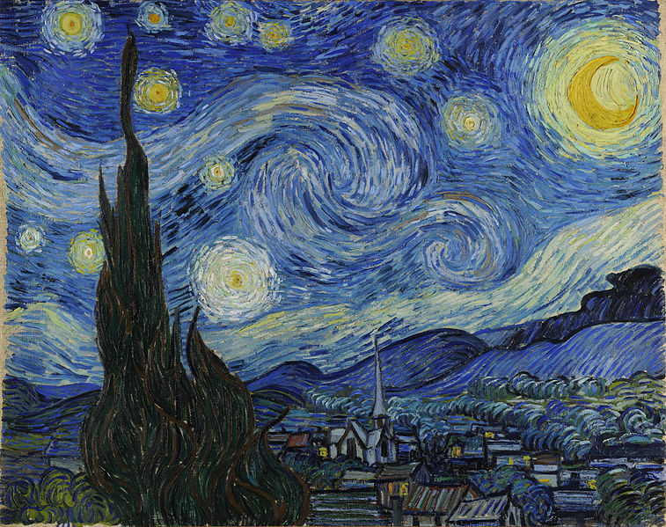
Vincent Van Gogh, Starry Night, 1889

Slide 10
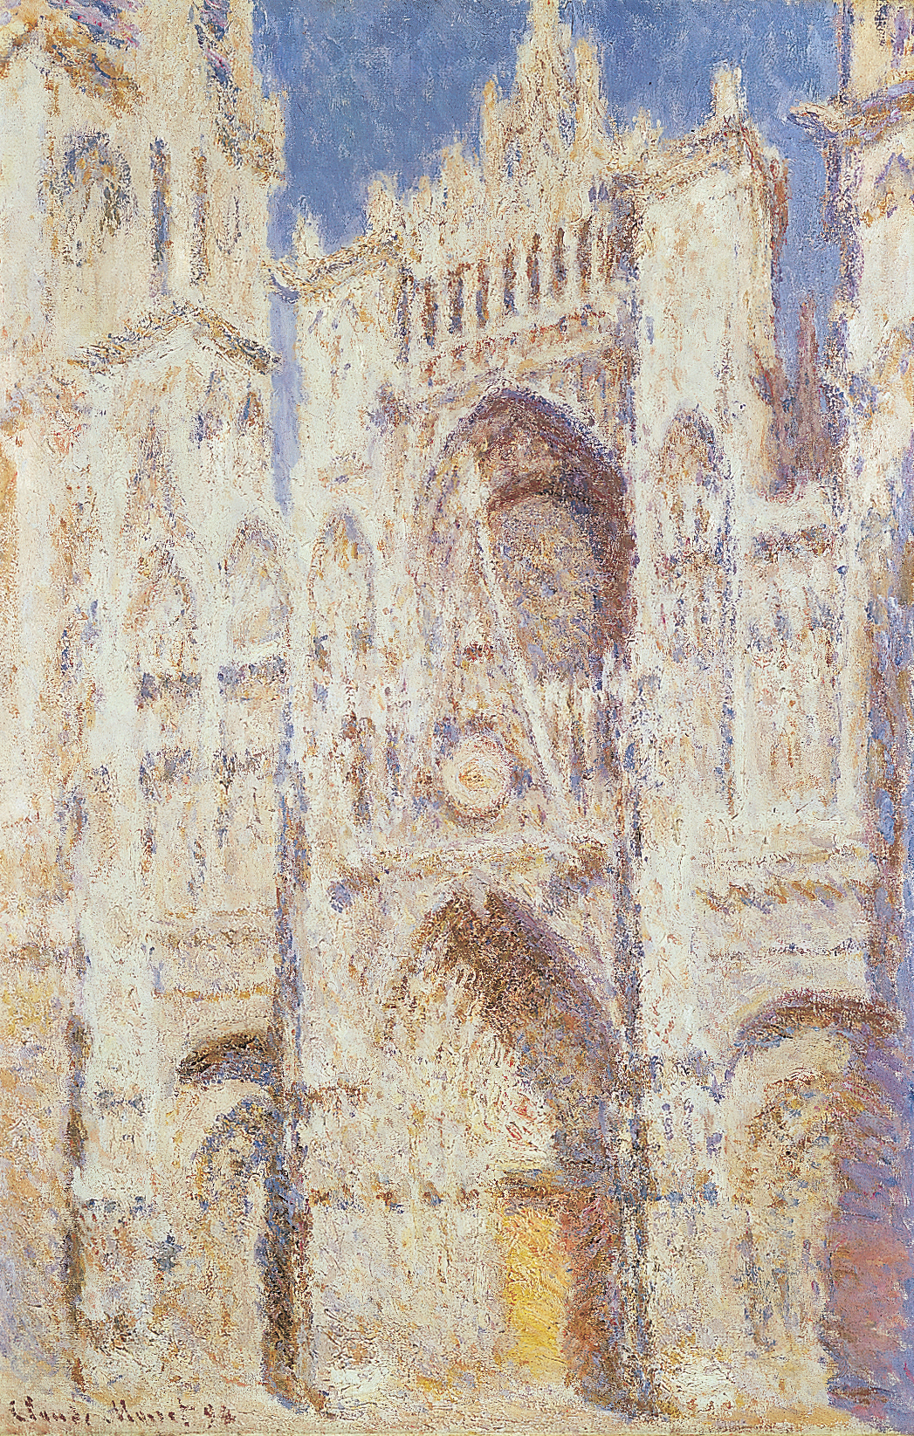
CLAUDE MONET, Rouen Cathedral: The Portal (in Sun), 1894. Oil on canvas, 3’ 3 1/4” x 2’ 1 7/8”. Metropolitan Museum of Art, New York (Theodore M. Davis Collection, bequest of Theodore M. Davis, 1915).
<number>
Notes:
<number>

Slide 11
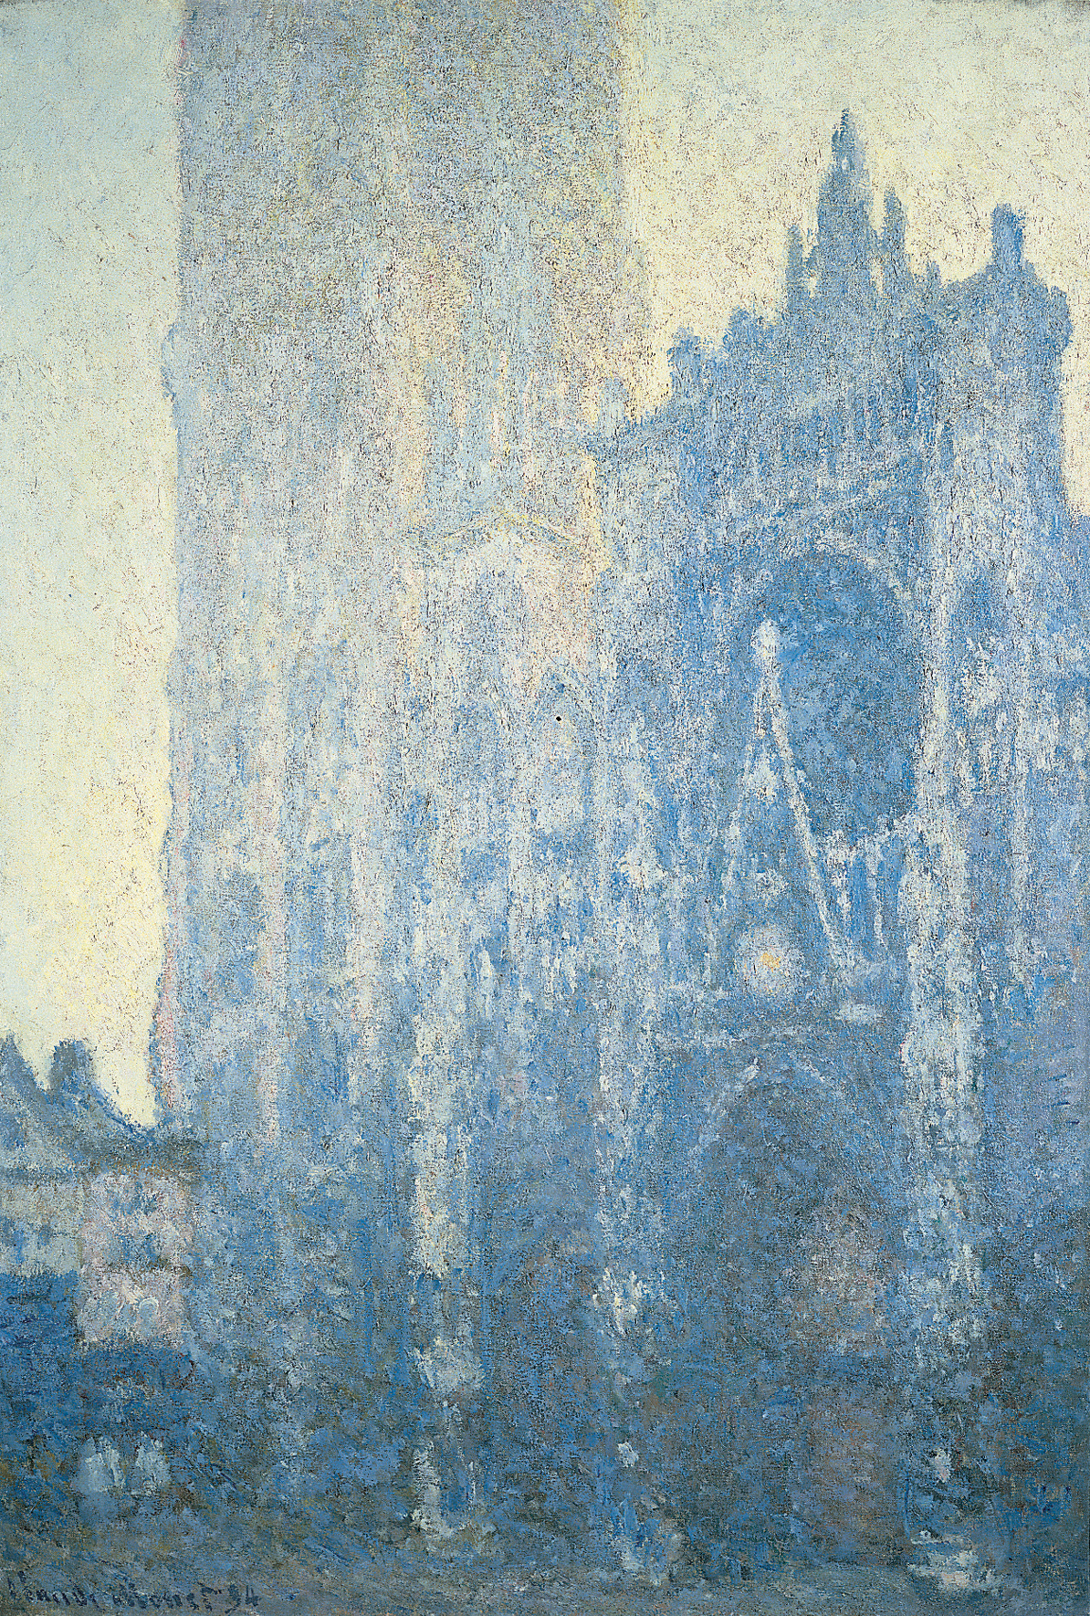

Slide 12
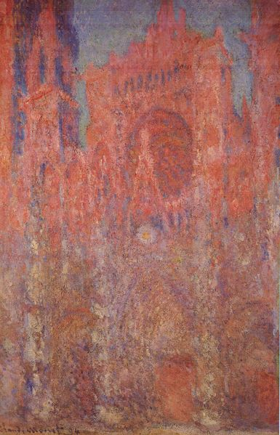

Slide 13
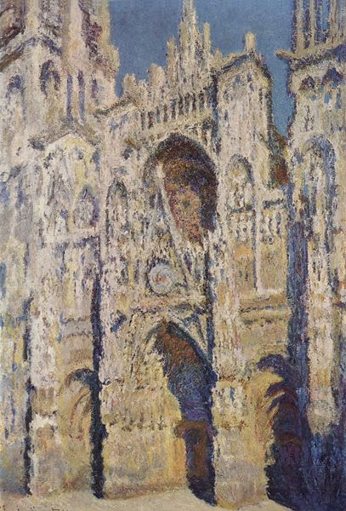

Slide 14
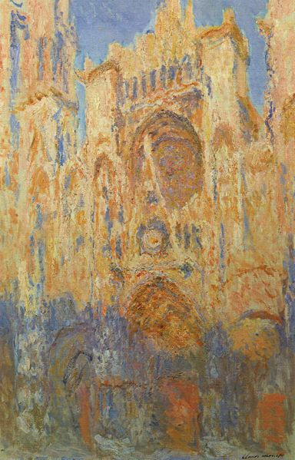

Slide 15
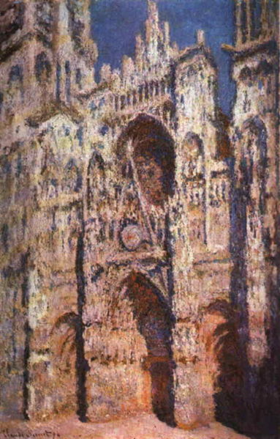

Slide 16
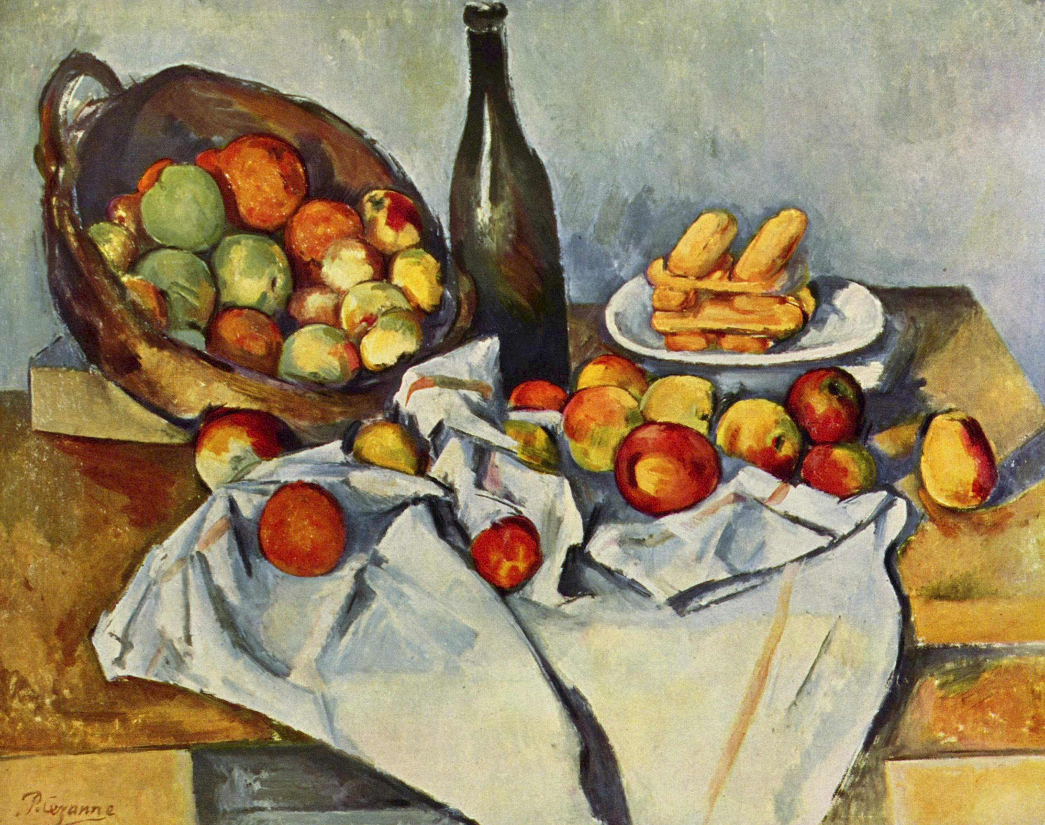
Paul Cezanne, The Basket of Apples, 1895

Slide 17
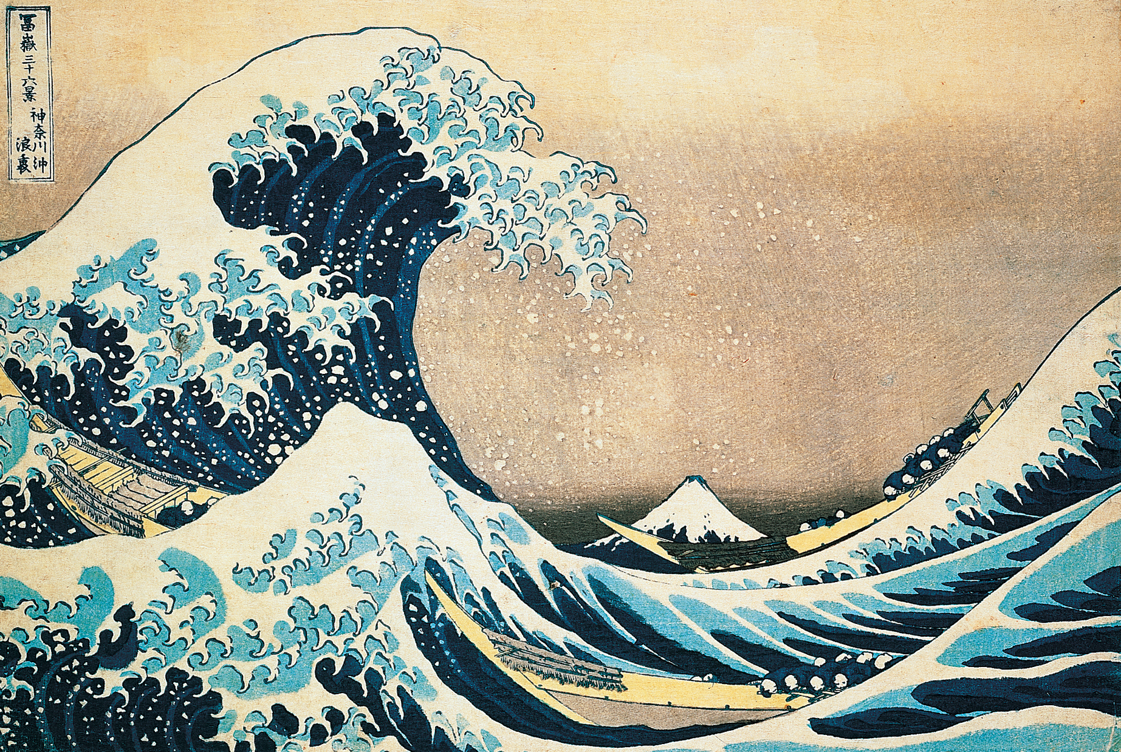
<number>
KATSUSHIKA HOKUSAI, The Great Wave off Kanagawa, from Thirty-Six Views of Mount Fuji,
Edo period, ca. 1826–1833. Woodblock print, ink and colors on paper, 9 7/8” x 1’ 2 3/4”.
Museum of Fine Arts, Boston (Bigelow Collection).
Notes:
<number>

