Slide 1
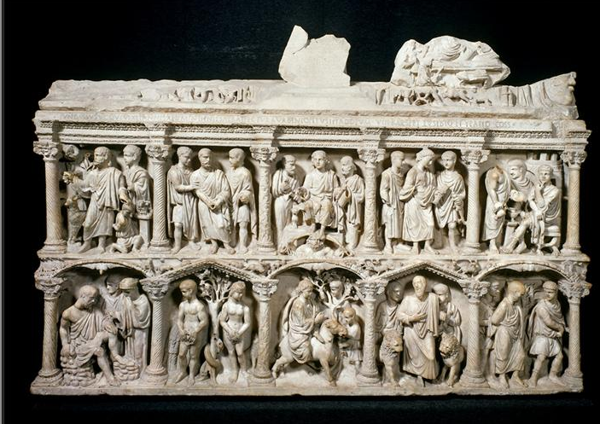
Sarcophagus of Junius Bassus, 359 CE

Slide 2
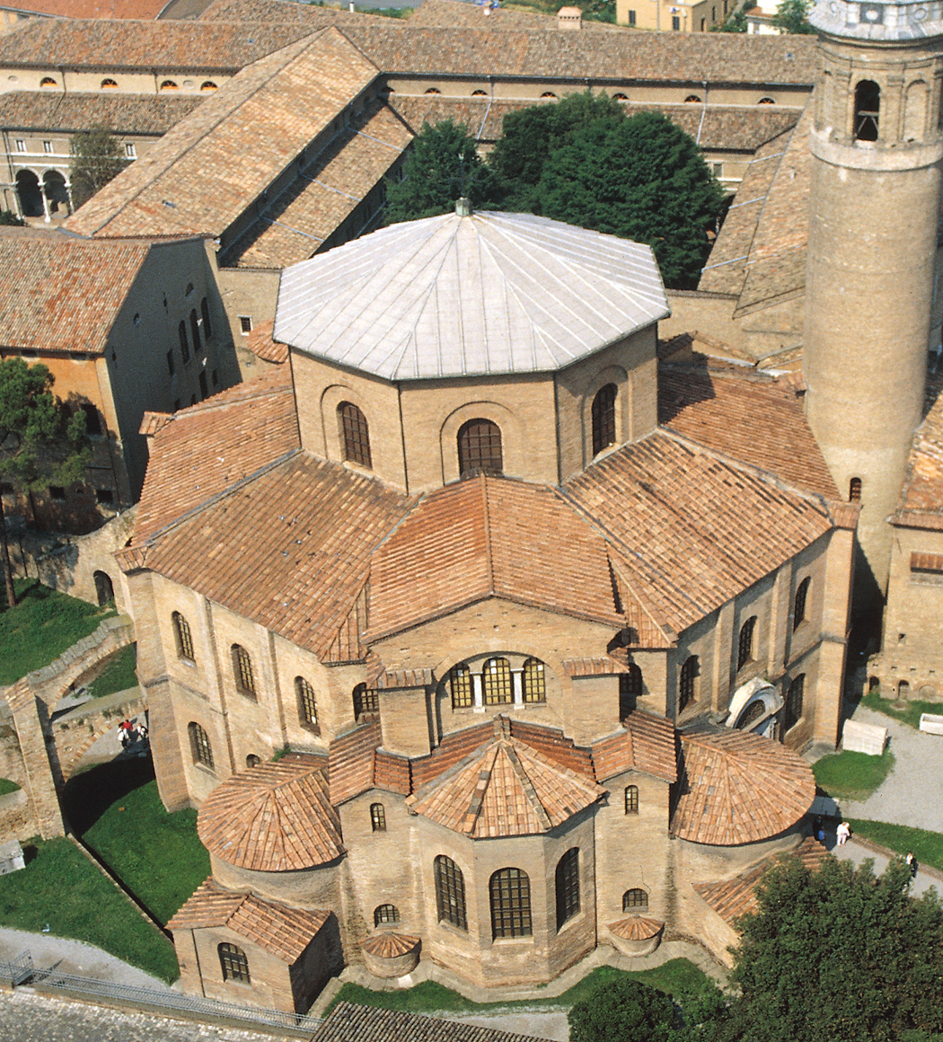
Aerial view of San Vitale (looking northwest), Ravenna, Italy, 526–547.
<number>
Notes:
<number>

Slide 3
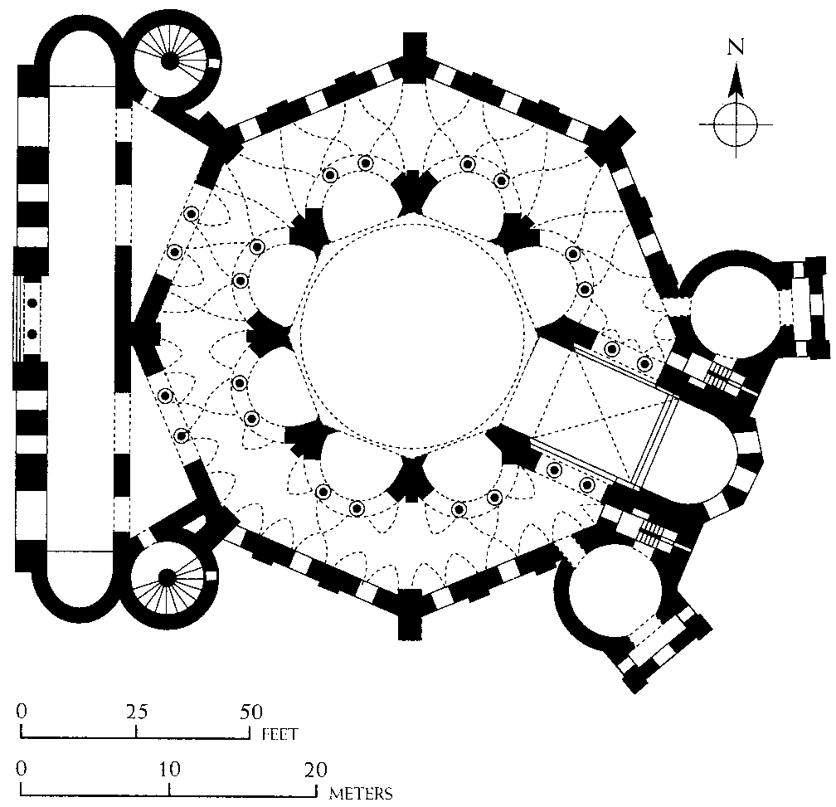
Plan of San Vitale, Ravenna, Italy, 526–547.
<number>
Notes:
<number>

Slide 4
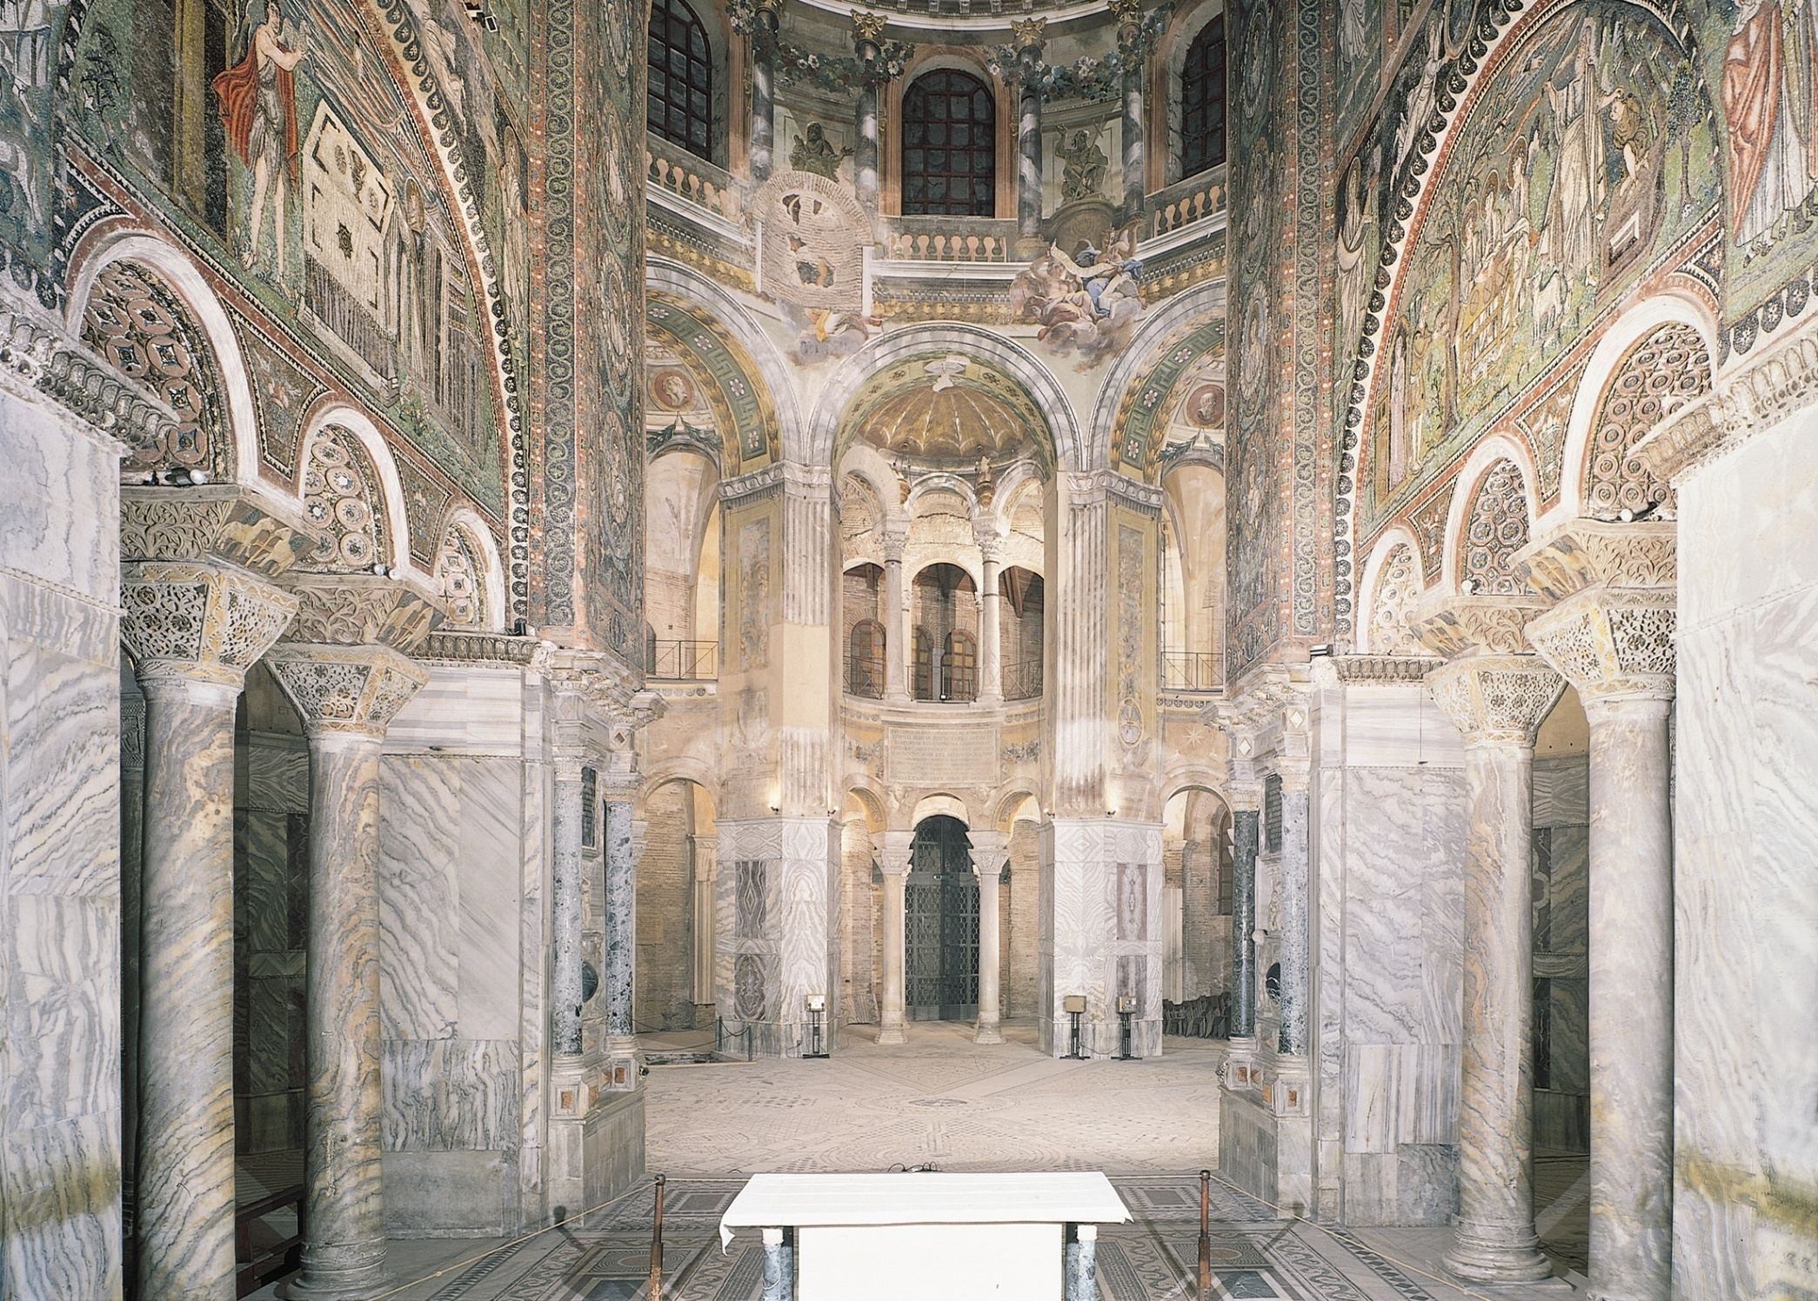
Interior of San Vitale (looking from the apse into the choir), Ravenna, Italy, 526–547.
Notes:
<number>

Slide 5
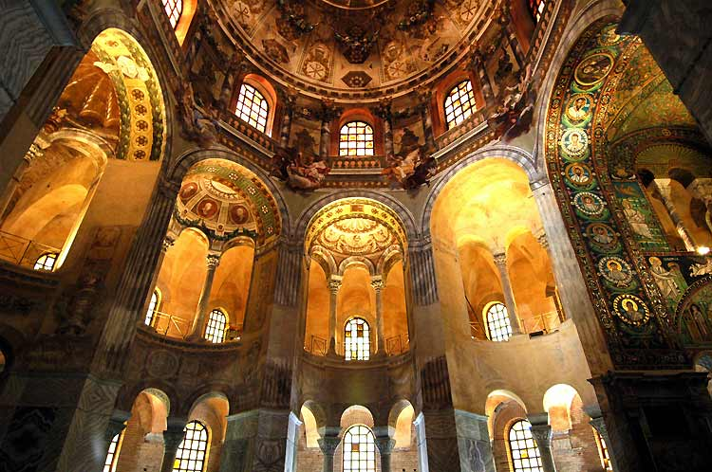

Slide 6
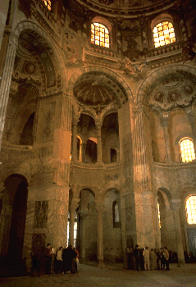

Slide 7
Interior of San Vitale (looking from the apse into the choir), Ravenna, Italy, 526–547.
Notes:
<number>

Slide 8
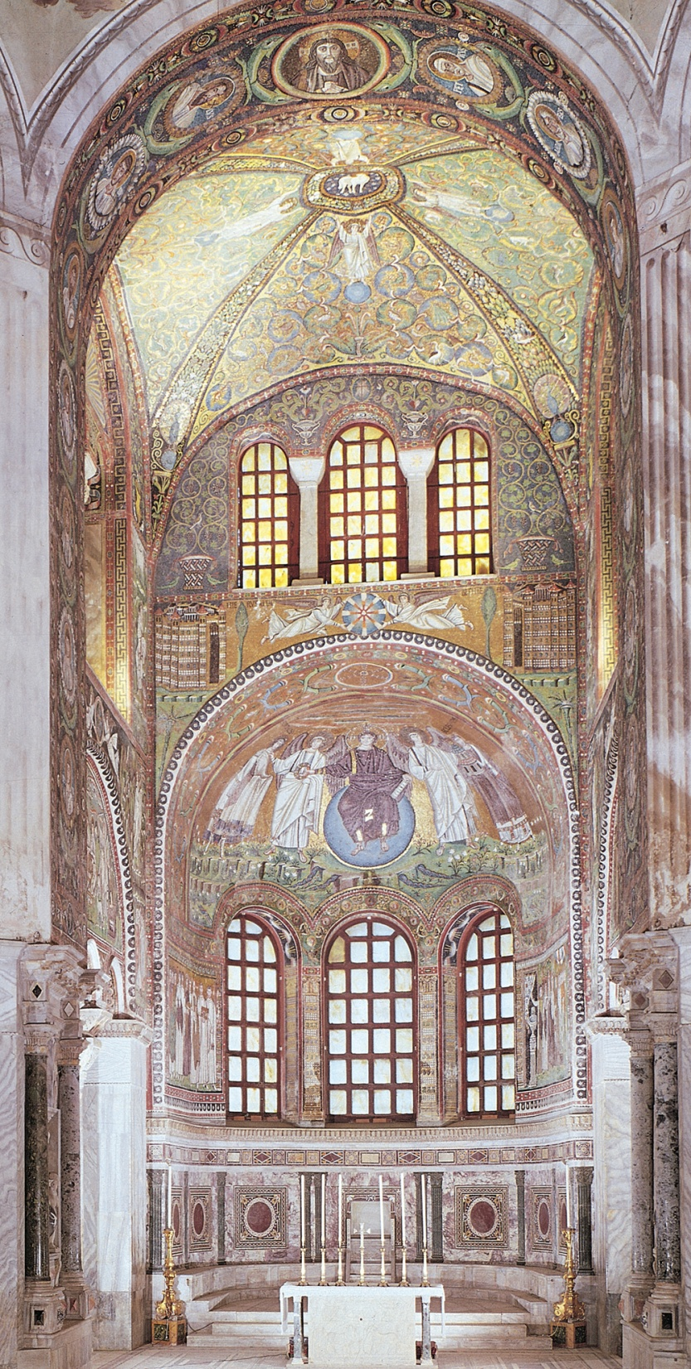
Choir and apse of San Vitale with mosaic of Christ between two angels, Saint Vitalis, and Bishop Ecclesius, Ravenna, Italy, 526–547.
Notes:
<number>

Slide 9
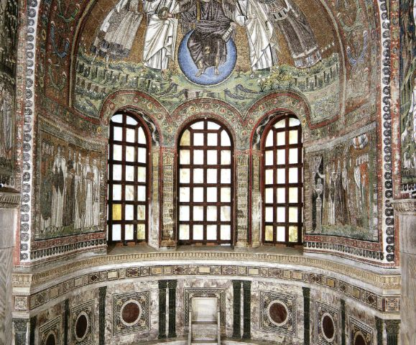

Slide 10
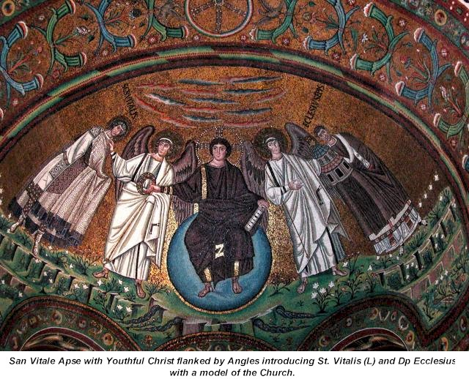

Slide 11
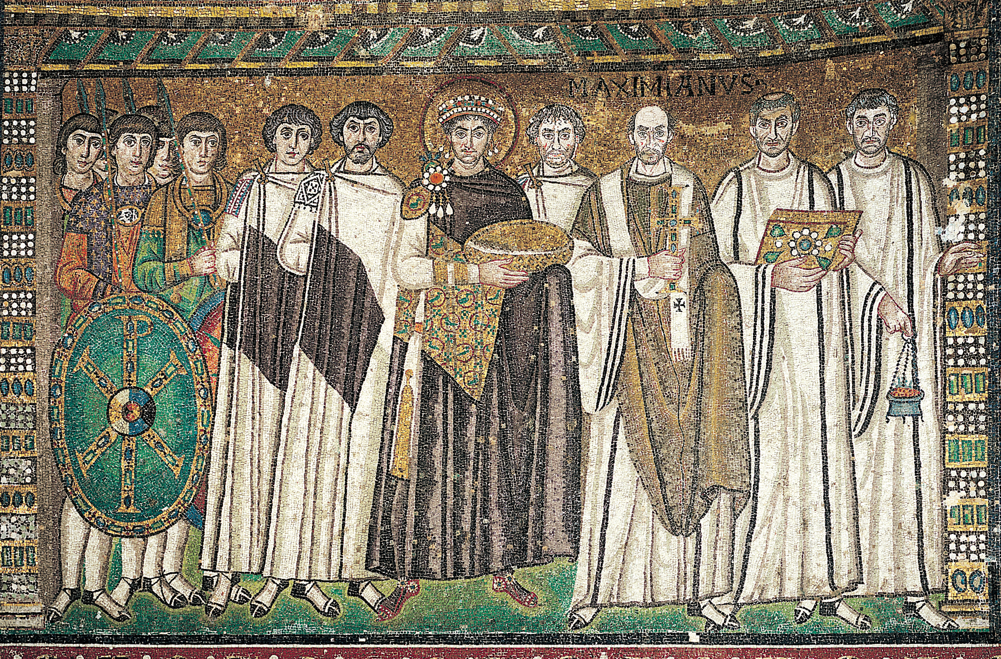
Justinian, Bishop Maximianus, and attendants, mosaic on the north wall of the apse, San Vitale, Ravenna, Italy, ca. 547.
Notes:
<number>

Slide 12
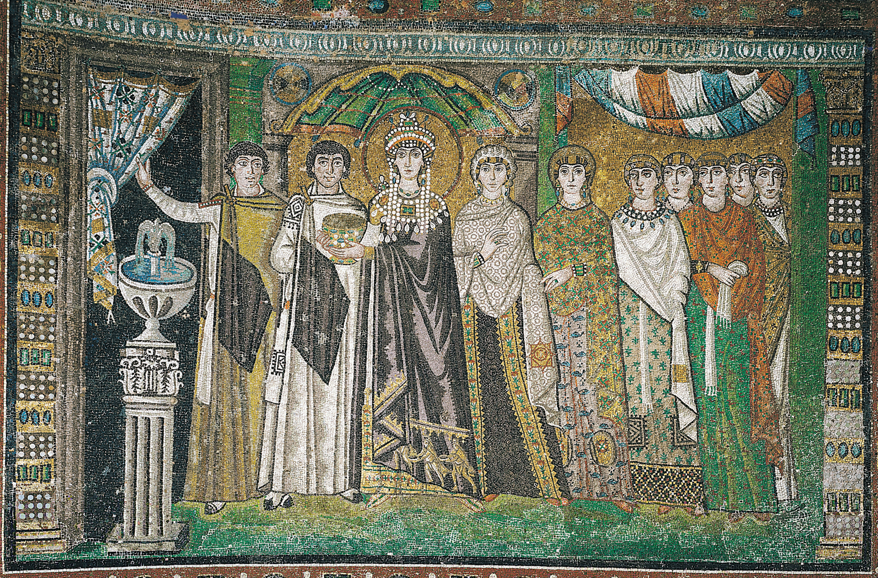
Theodora and attendants, mosaic on the south wall of the apse, San Vitale, Ravenna, Italy, ca. 547.
Notes:
<number>

Slide 13
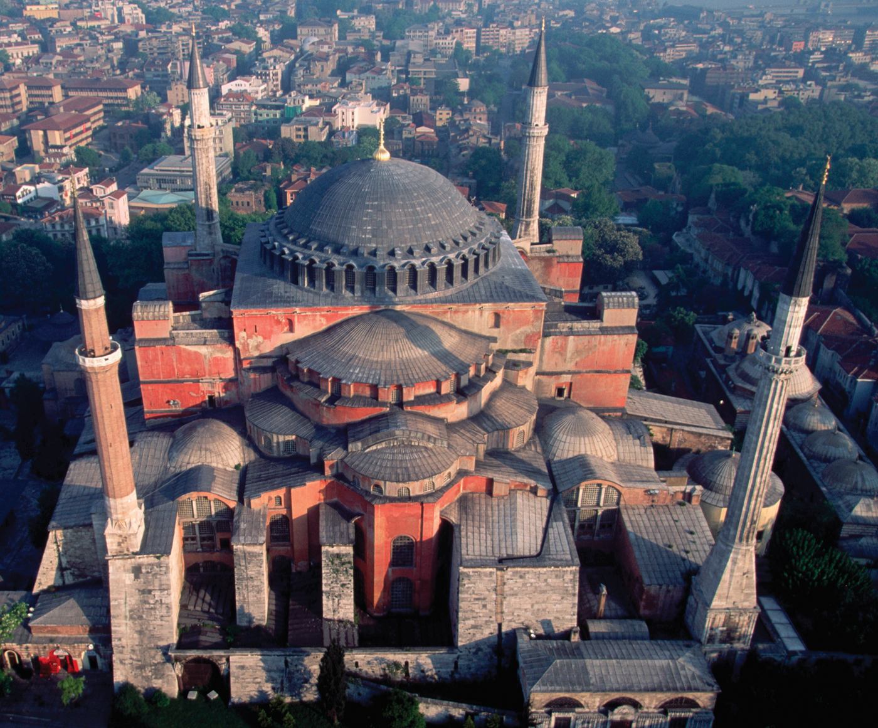
ANTHEMIUS OF TRALLES and ISIDORUS OF MILETUS, aerial view of Hagia Sophia (looking north), Constantinople (Istanbul), Turkey, 532–537.
Notes:
<number>

Slide 14
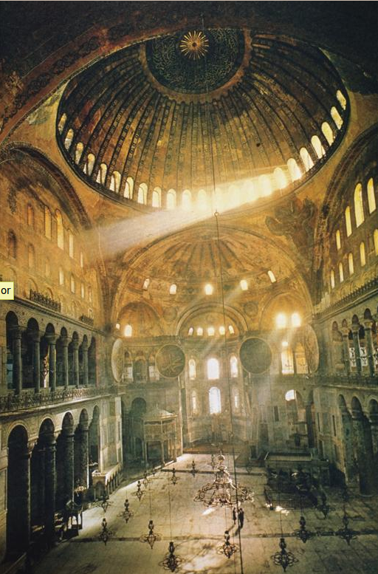

Slide 15
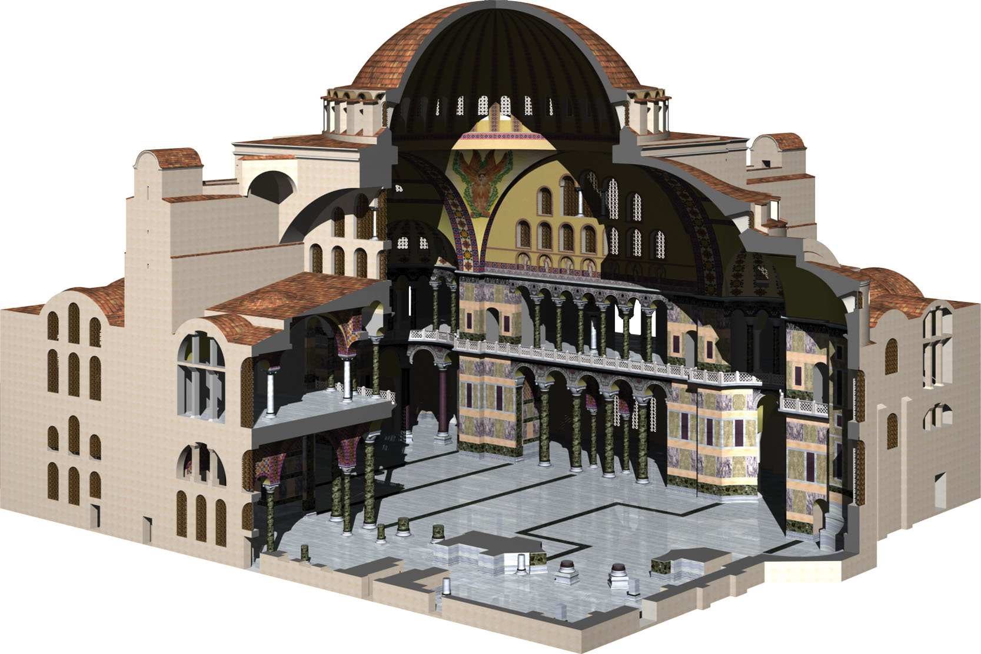
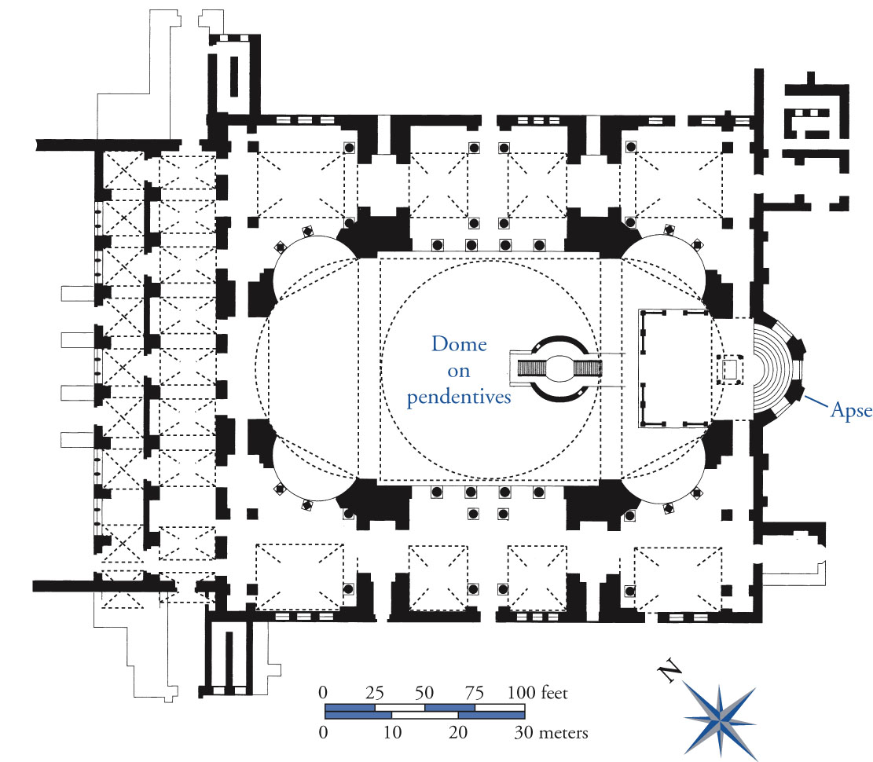
ANTHEMIUS OF TRALLES and ISIDORUS OF MILETUS, plan (top) and restored cutaway view (bottom) of Hagia Sophia, Constantinople (Istanbul), Turkey, 532-537 (John Burge).
<number>
Notes:
<number>

Slide 16
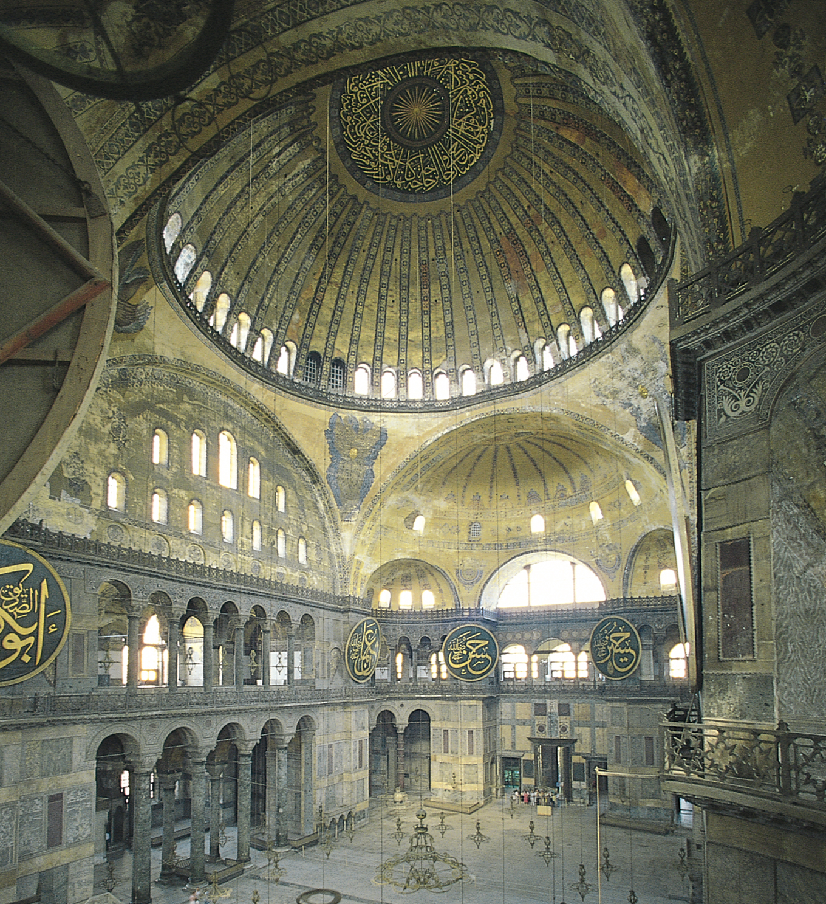
ANTHEMIUS OF TRALLES and ISIDORUS OF MILETUS, interior of Hagia Sophia (looking southwest), Constantinople (Istanbul), Turkey, 532–537.
Notes:
<number>

Slide 17
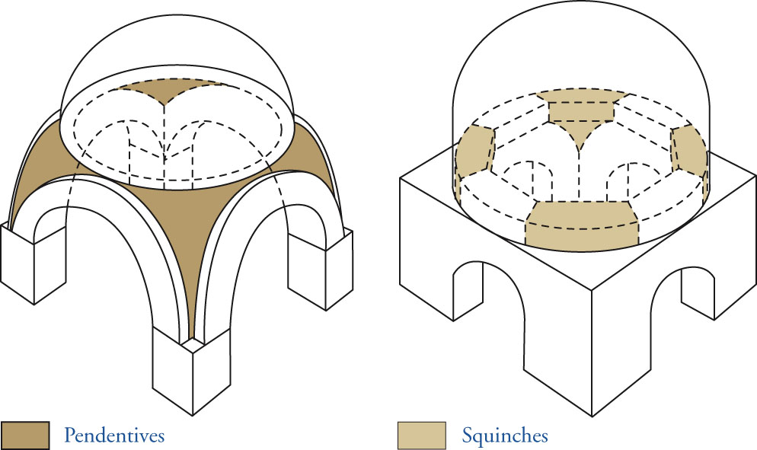
Dome on pendentives (left) and on squinches (right).
<number>
Notes:
<number>

Slide 18
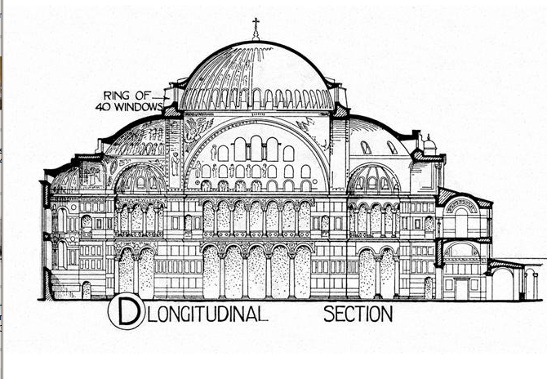

Slide 19
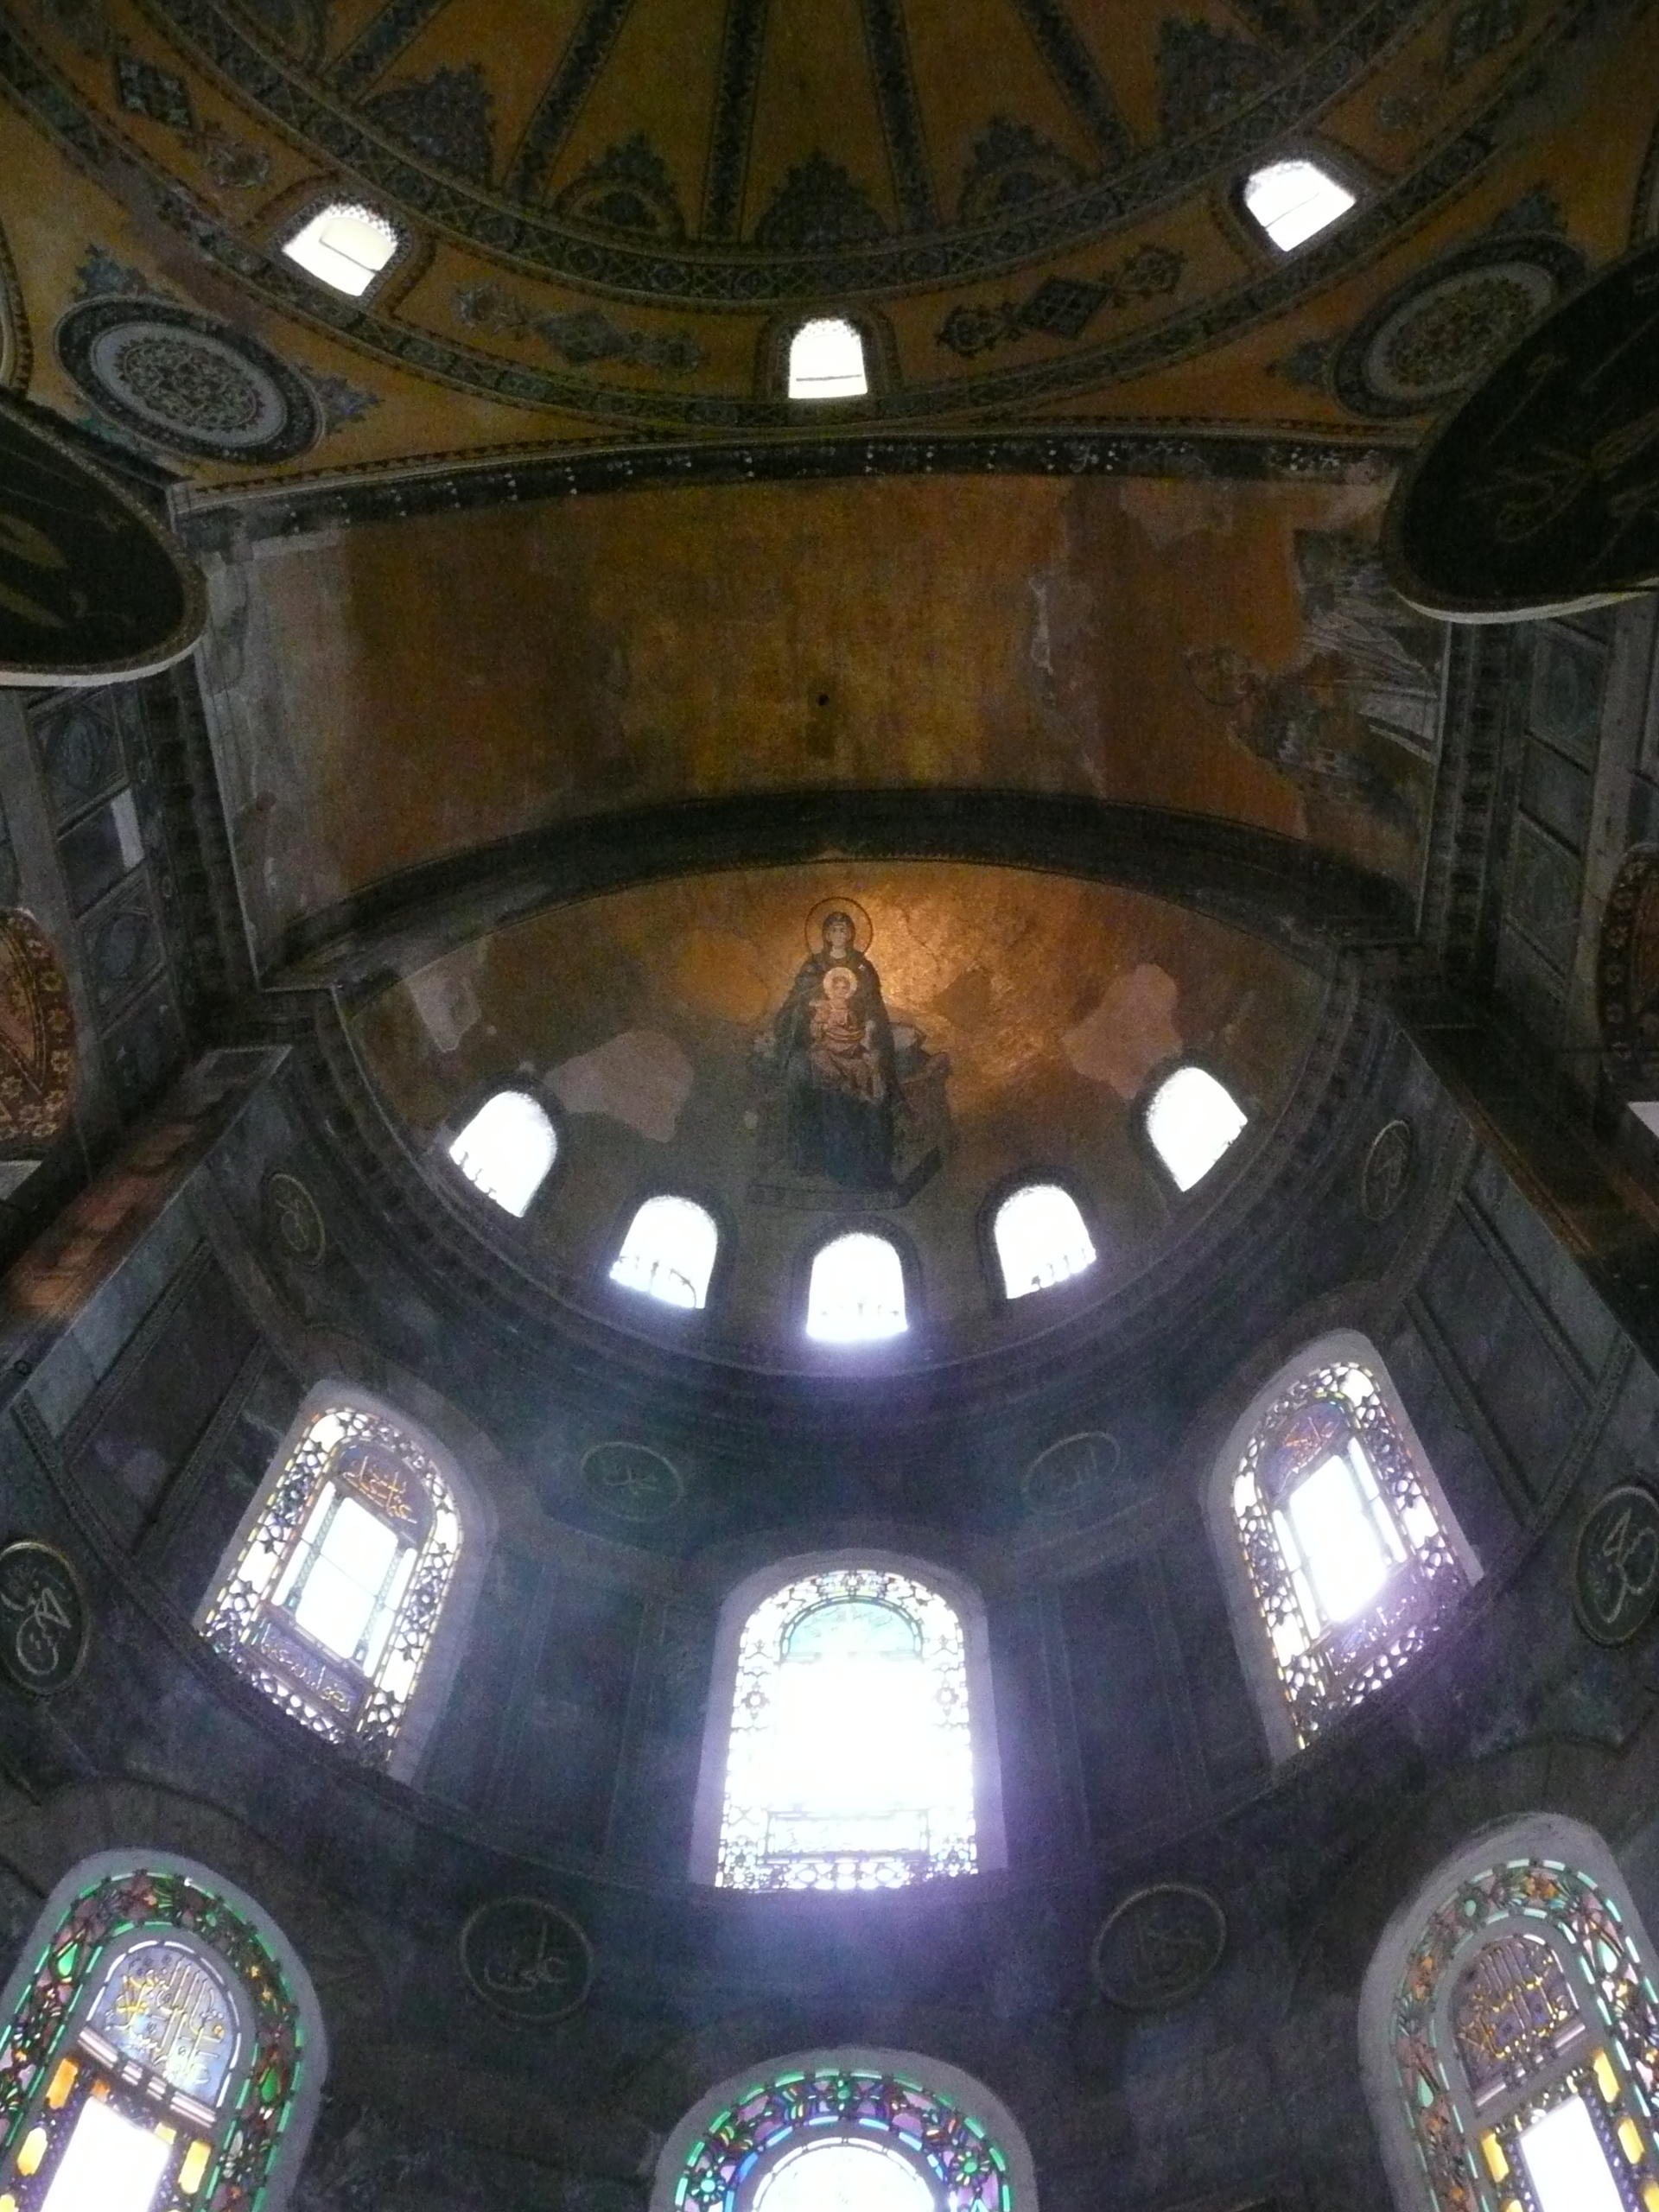

Slide 20
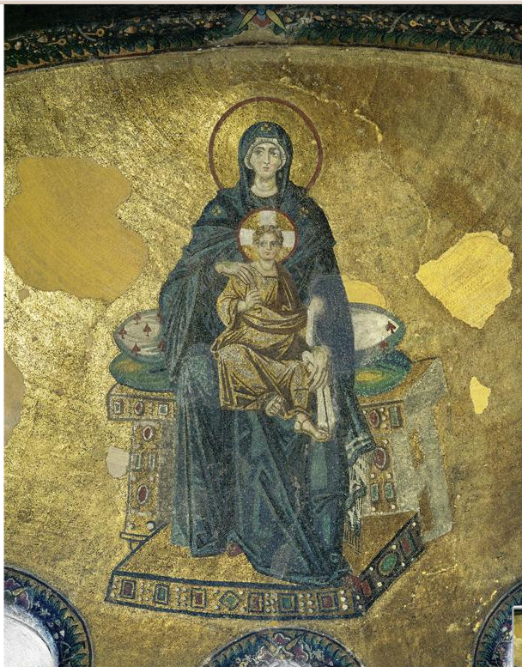

Slide 21
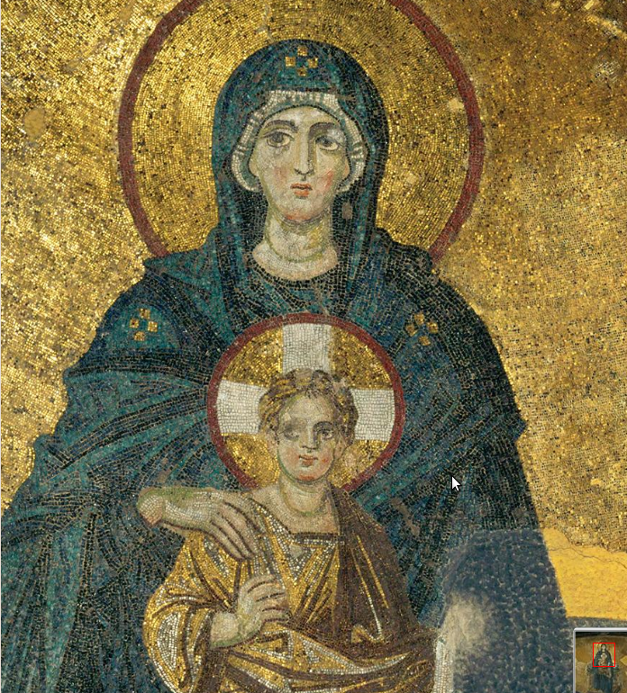

Slide 22
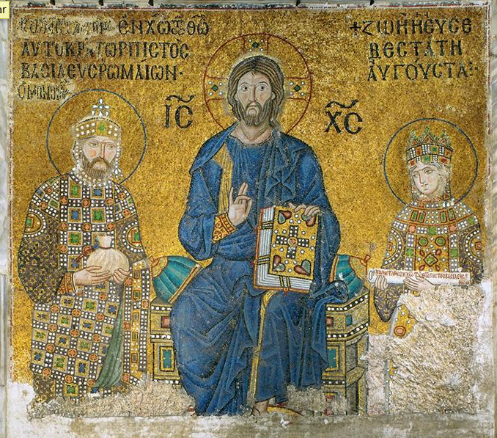

Slide 23
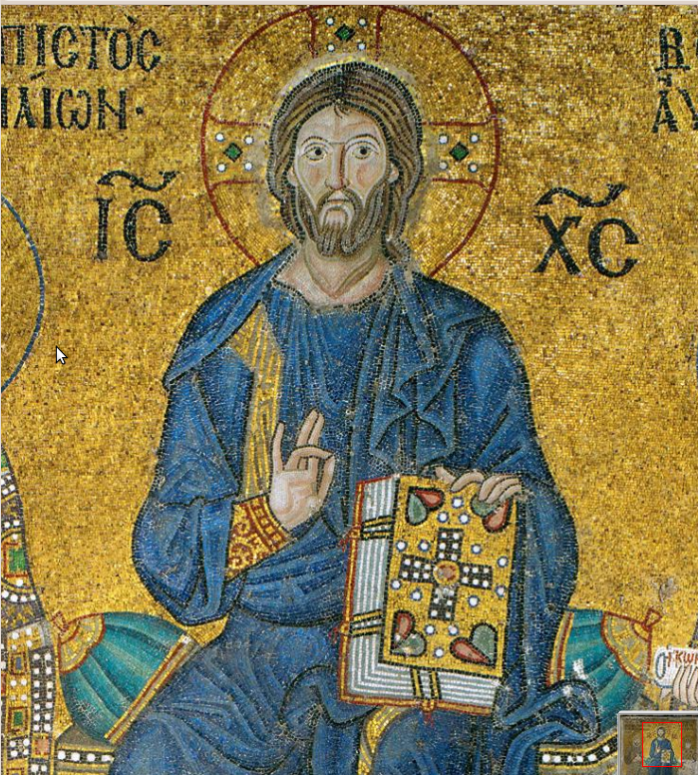

Slide 24
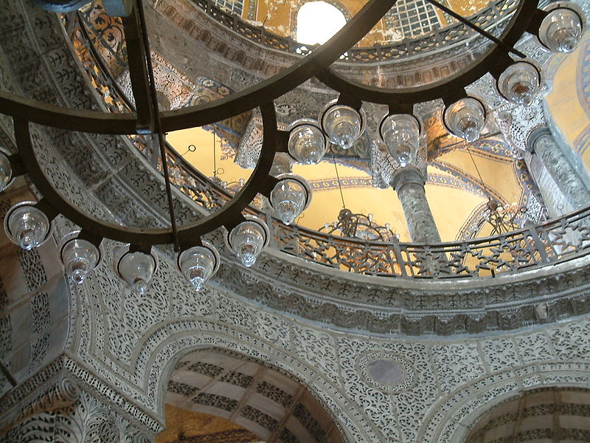

Slide 25
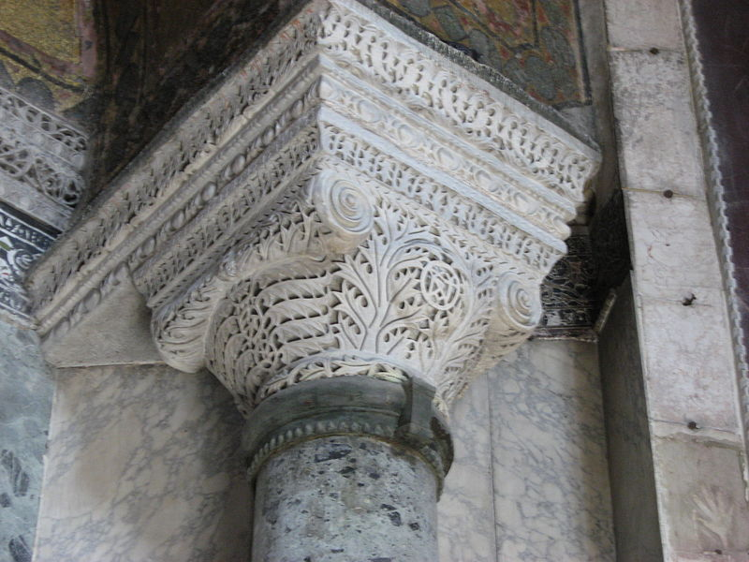

Slide 26
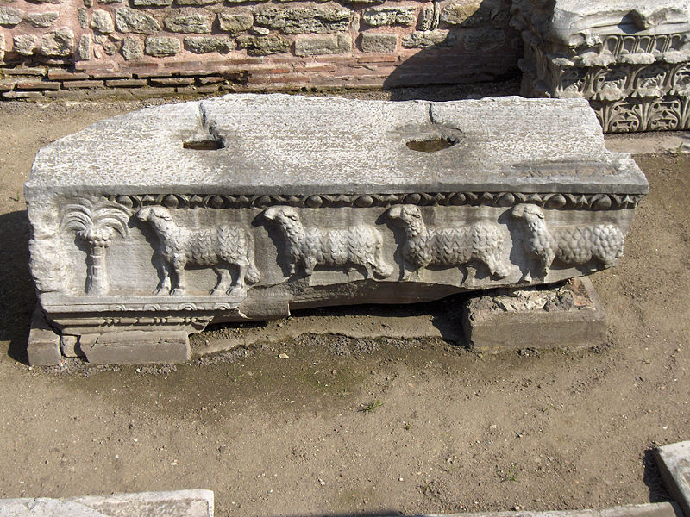

Slide 27
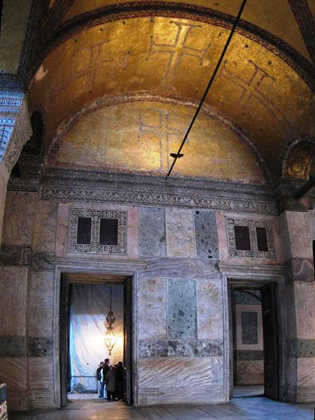

Slide 28
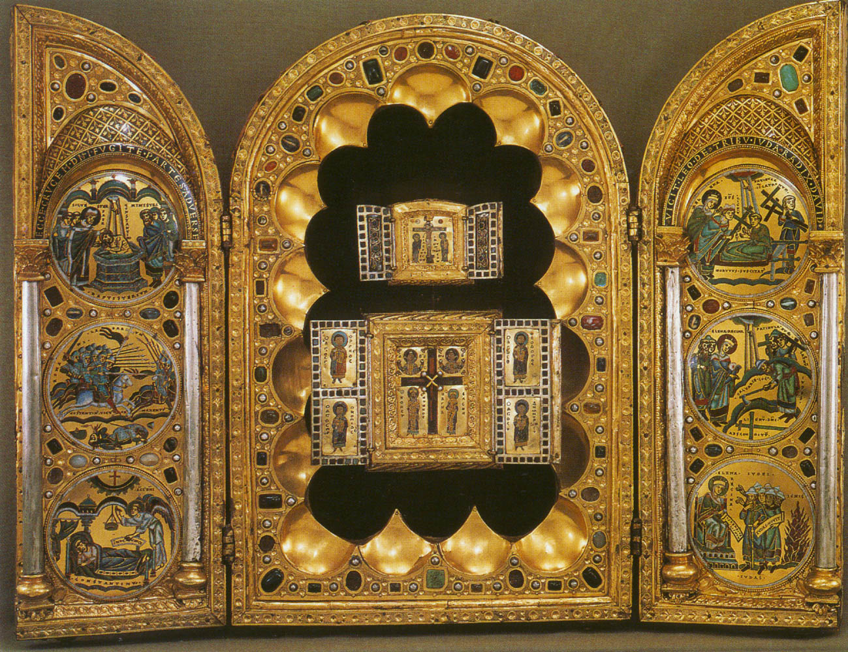

Slide 29
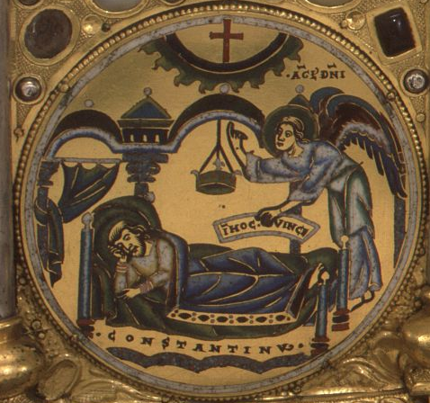
Dream of Constantine

Slide 30
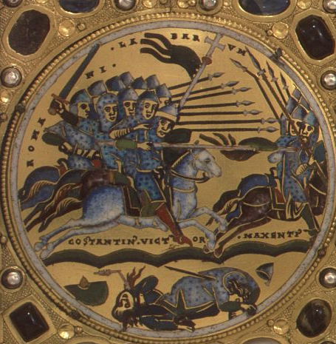
Battle of Milvian Bridge

Slide 31
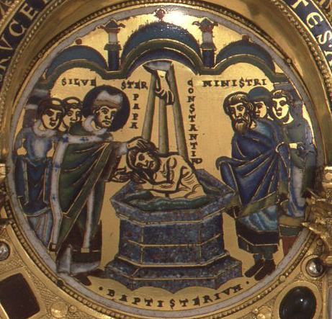
Baptism of Constantine

Slide 32
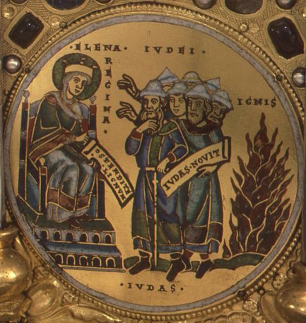
St. Helena, mother of Constantine, threatens the Jewish elders

Slide 33
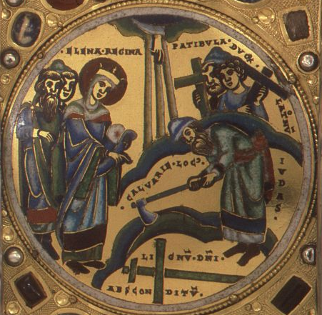
St. Helena orders the Jews to dig under the Temple of Venus

Slide 34
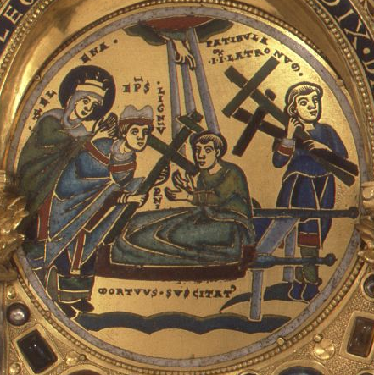
The True Cross heals a man

Slide 35
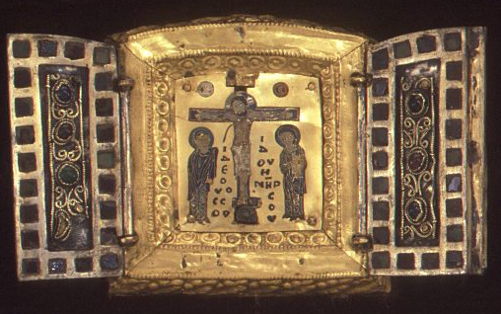
Upper Byzantine triptych

Slide 36
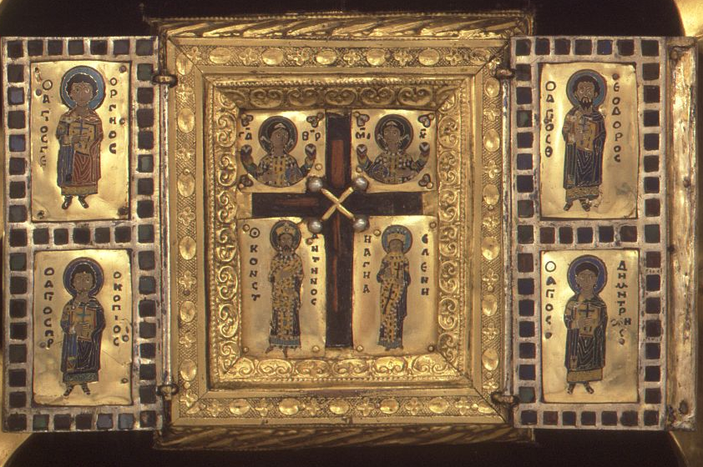
Lower Byzantine triptych

Slide 37
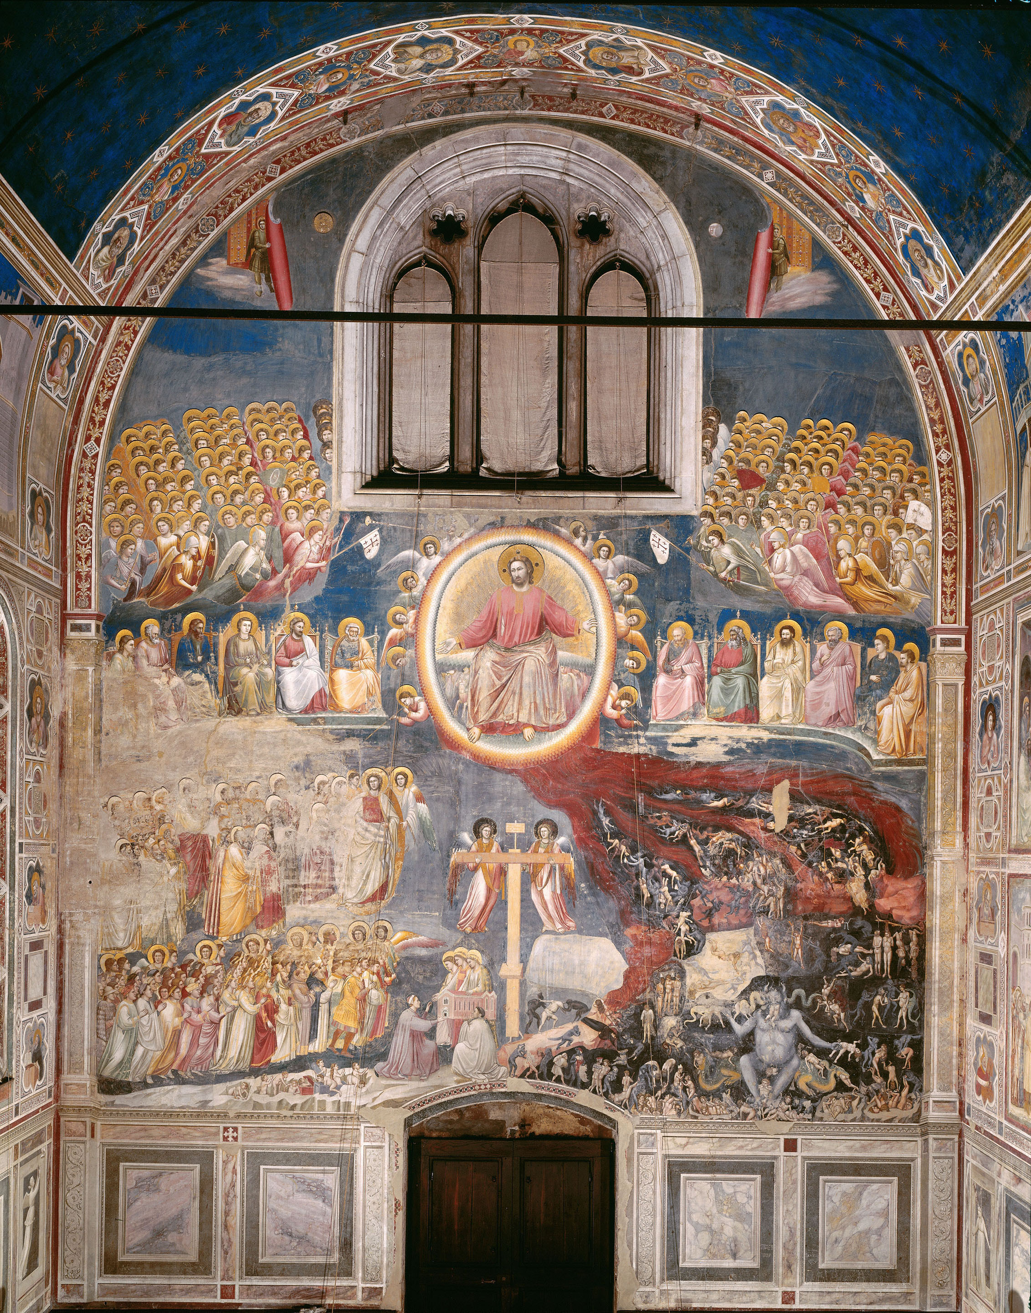

Slide 38
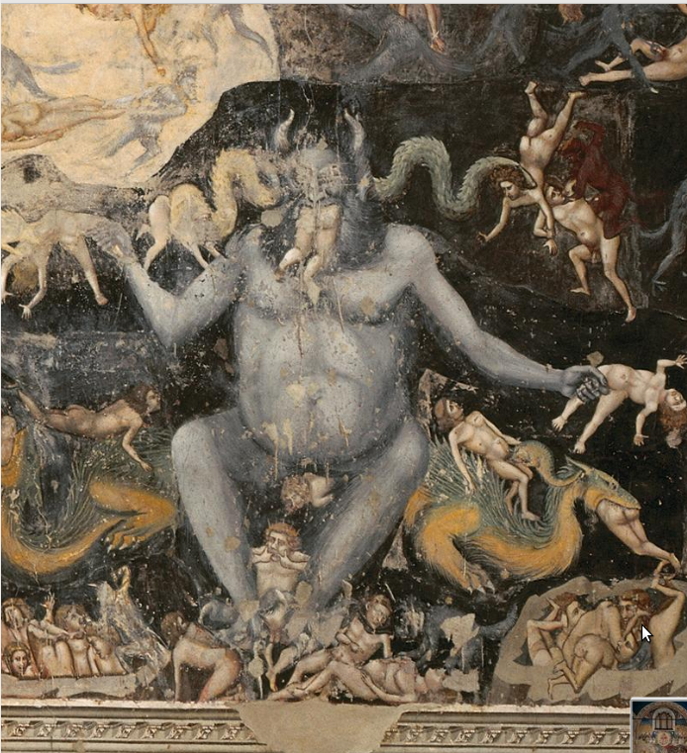

Slide 39
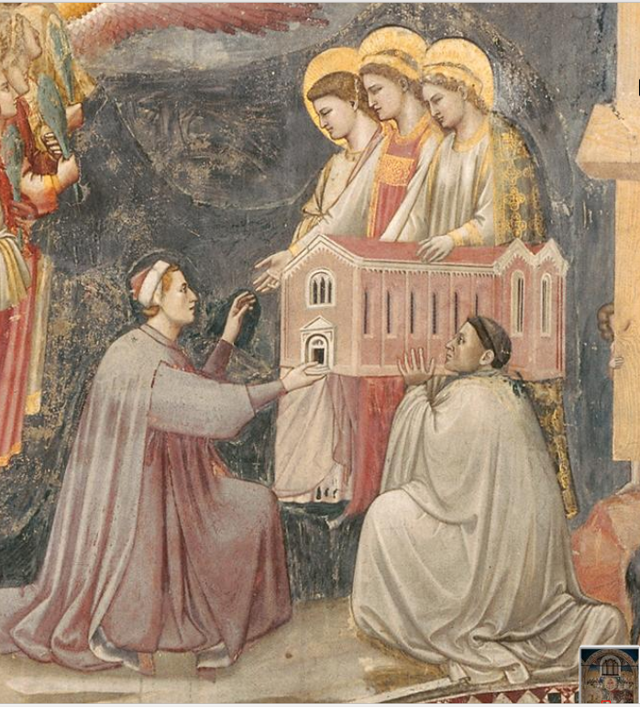

Slide 40
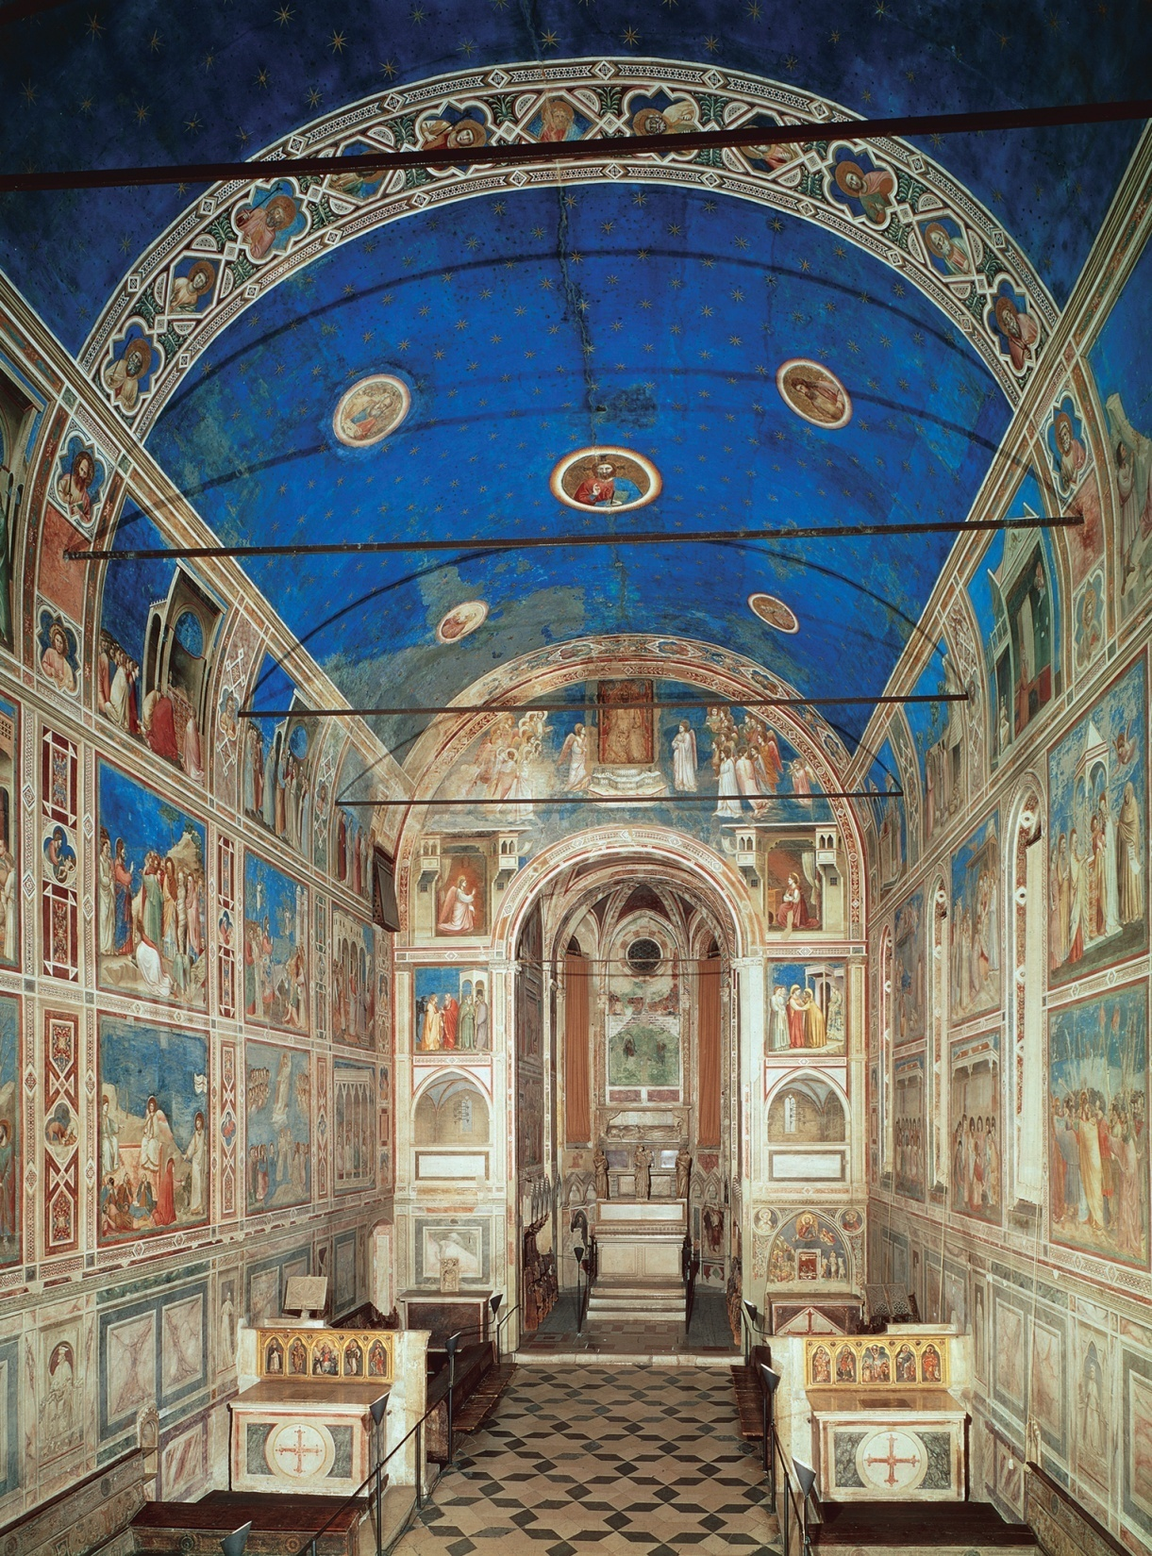
Giotto di Bondone, Arena Chapel (Cappella Scrovegni; interior looking west), Padua, Italy, 1305–1306.
Notes:
<number>

Slide 41
Last Judgment on the West wall

Slide 42
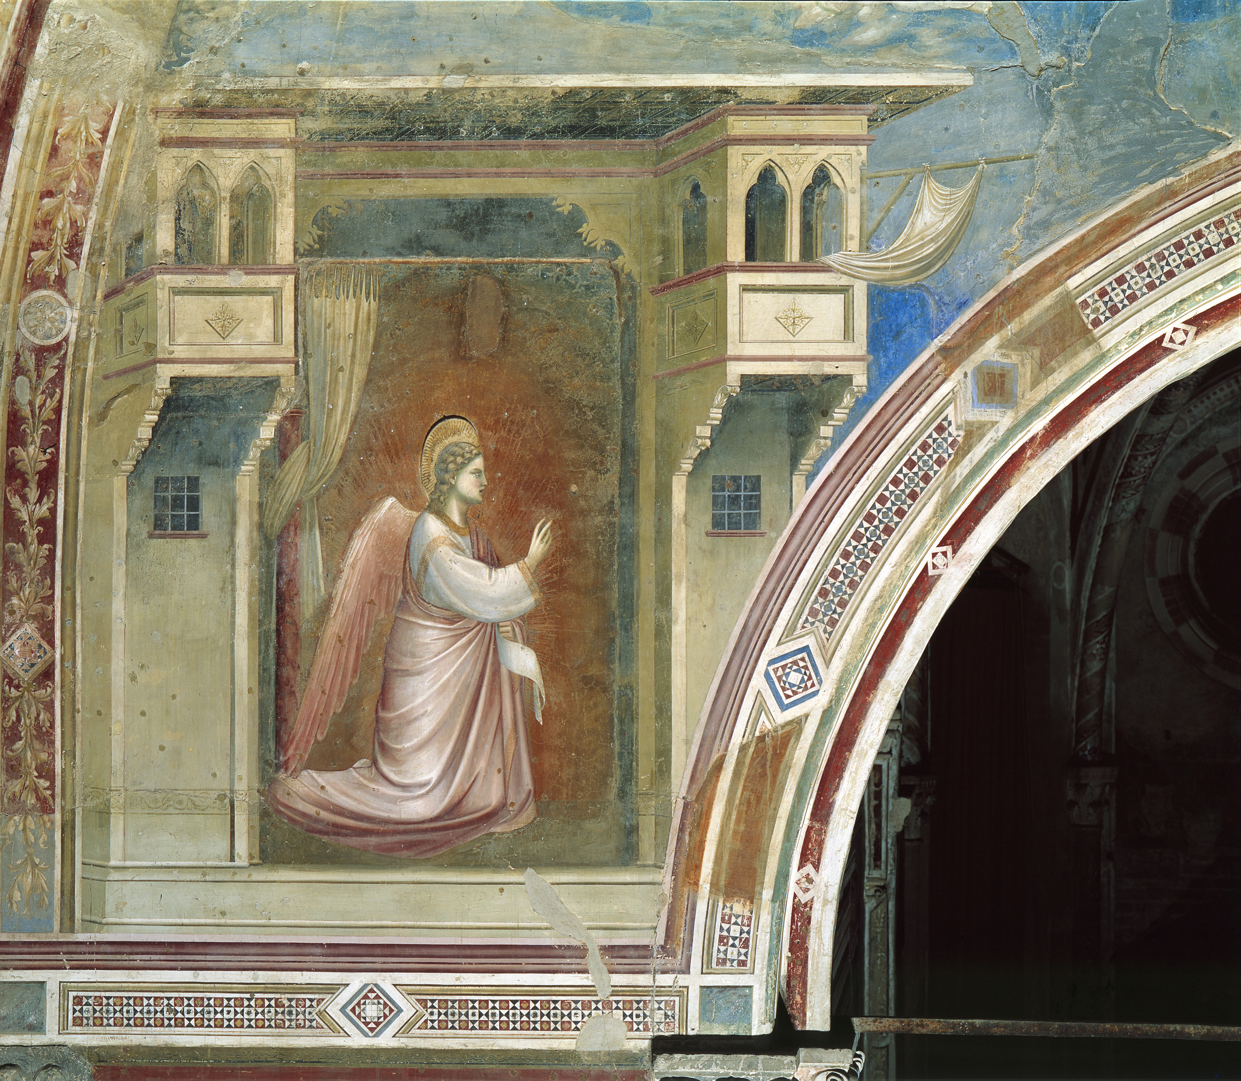
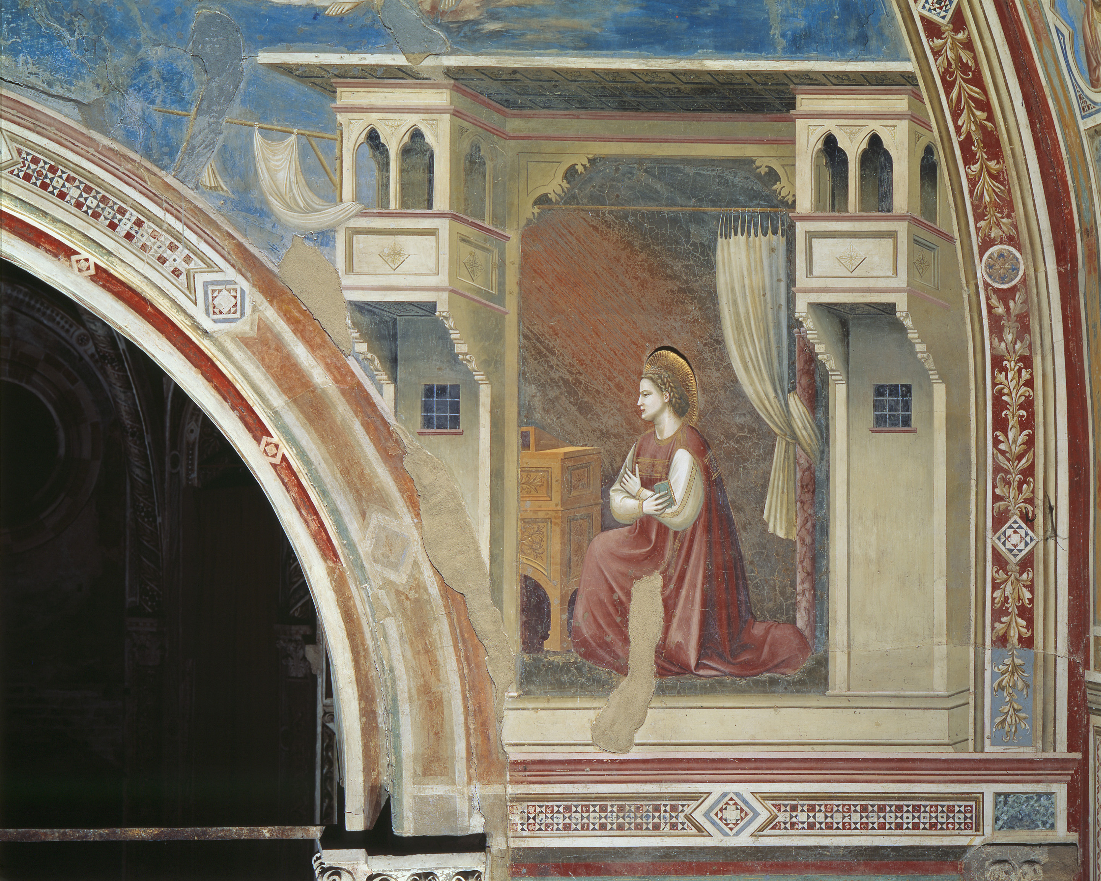
The story of the Life of Christ begins with the Annunciation, when the angel Gabriel visits Mary

Slide 43
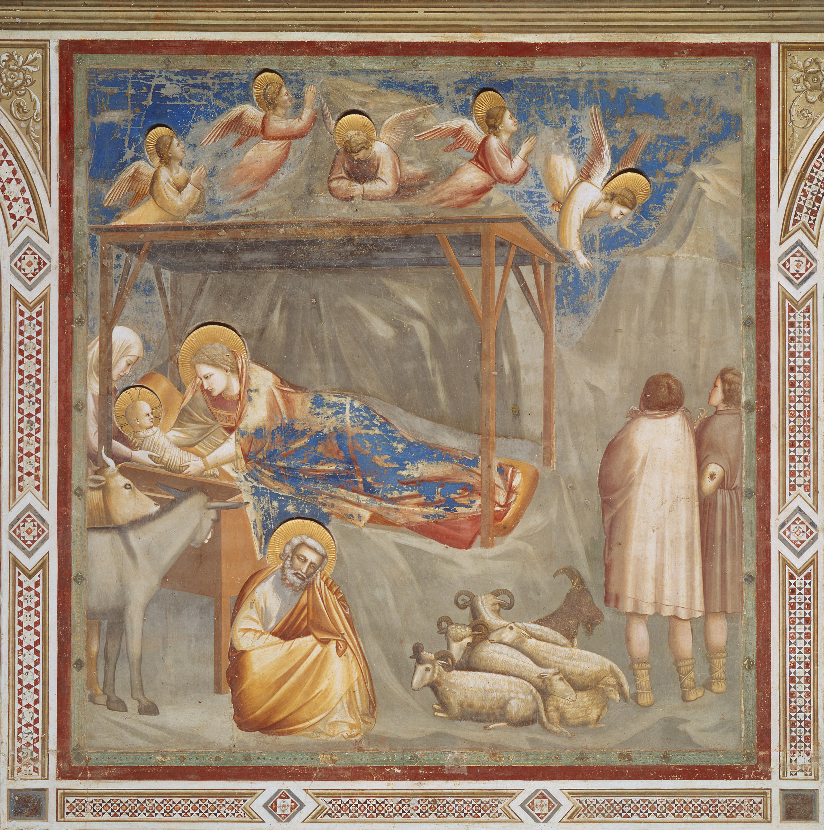
The Nativity, or birth of Christ

Slide 44
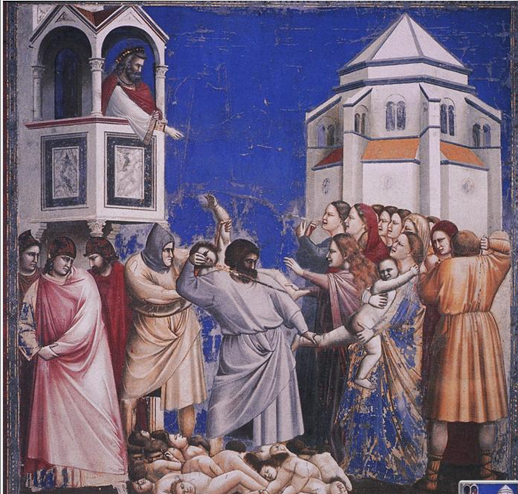
The Massacre of the Innocents, when Herod orders the death of all infant boys

Slide 45
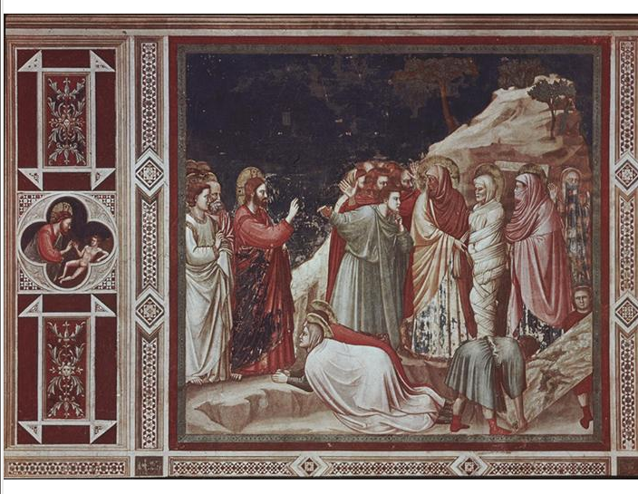
The Raising of Lazarus, when Christ raises Lazarus from the dead

Slide 46
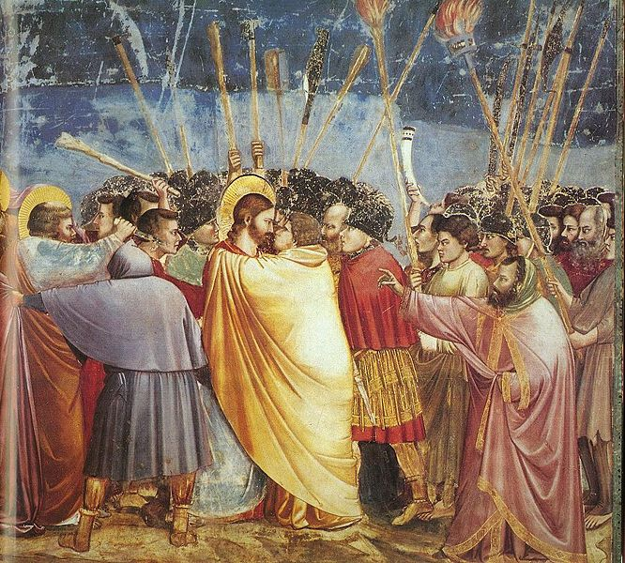
The Kiss of Judas, when Judas betrays Christ to the Pharisees

Slide 47
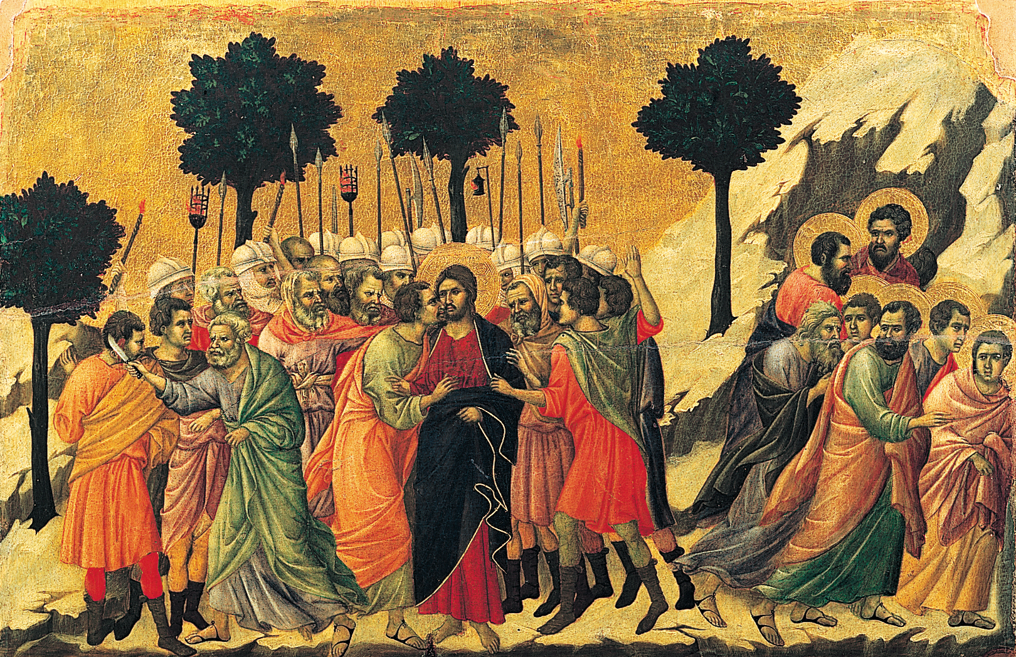
DUCCIO DI BUONINSEGNA, Betrayal of Jesus, detail from the back of the Maestà altarpiece, from Siena Cathedral, Siena, Italy, 1309–1311. Tempera and gold leaf on wood, detail 1’ 10 1/2” x 3’ 4”. Museo dell’Opera del Duomo, Siena.
Notes:
<number>

Slide 48
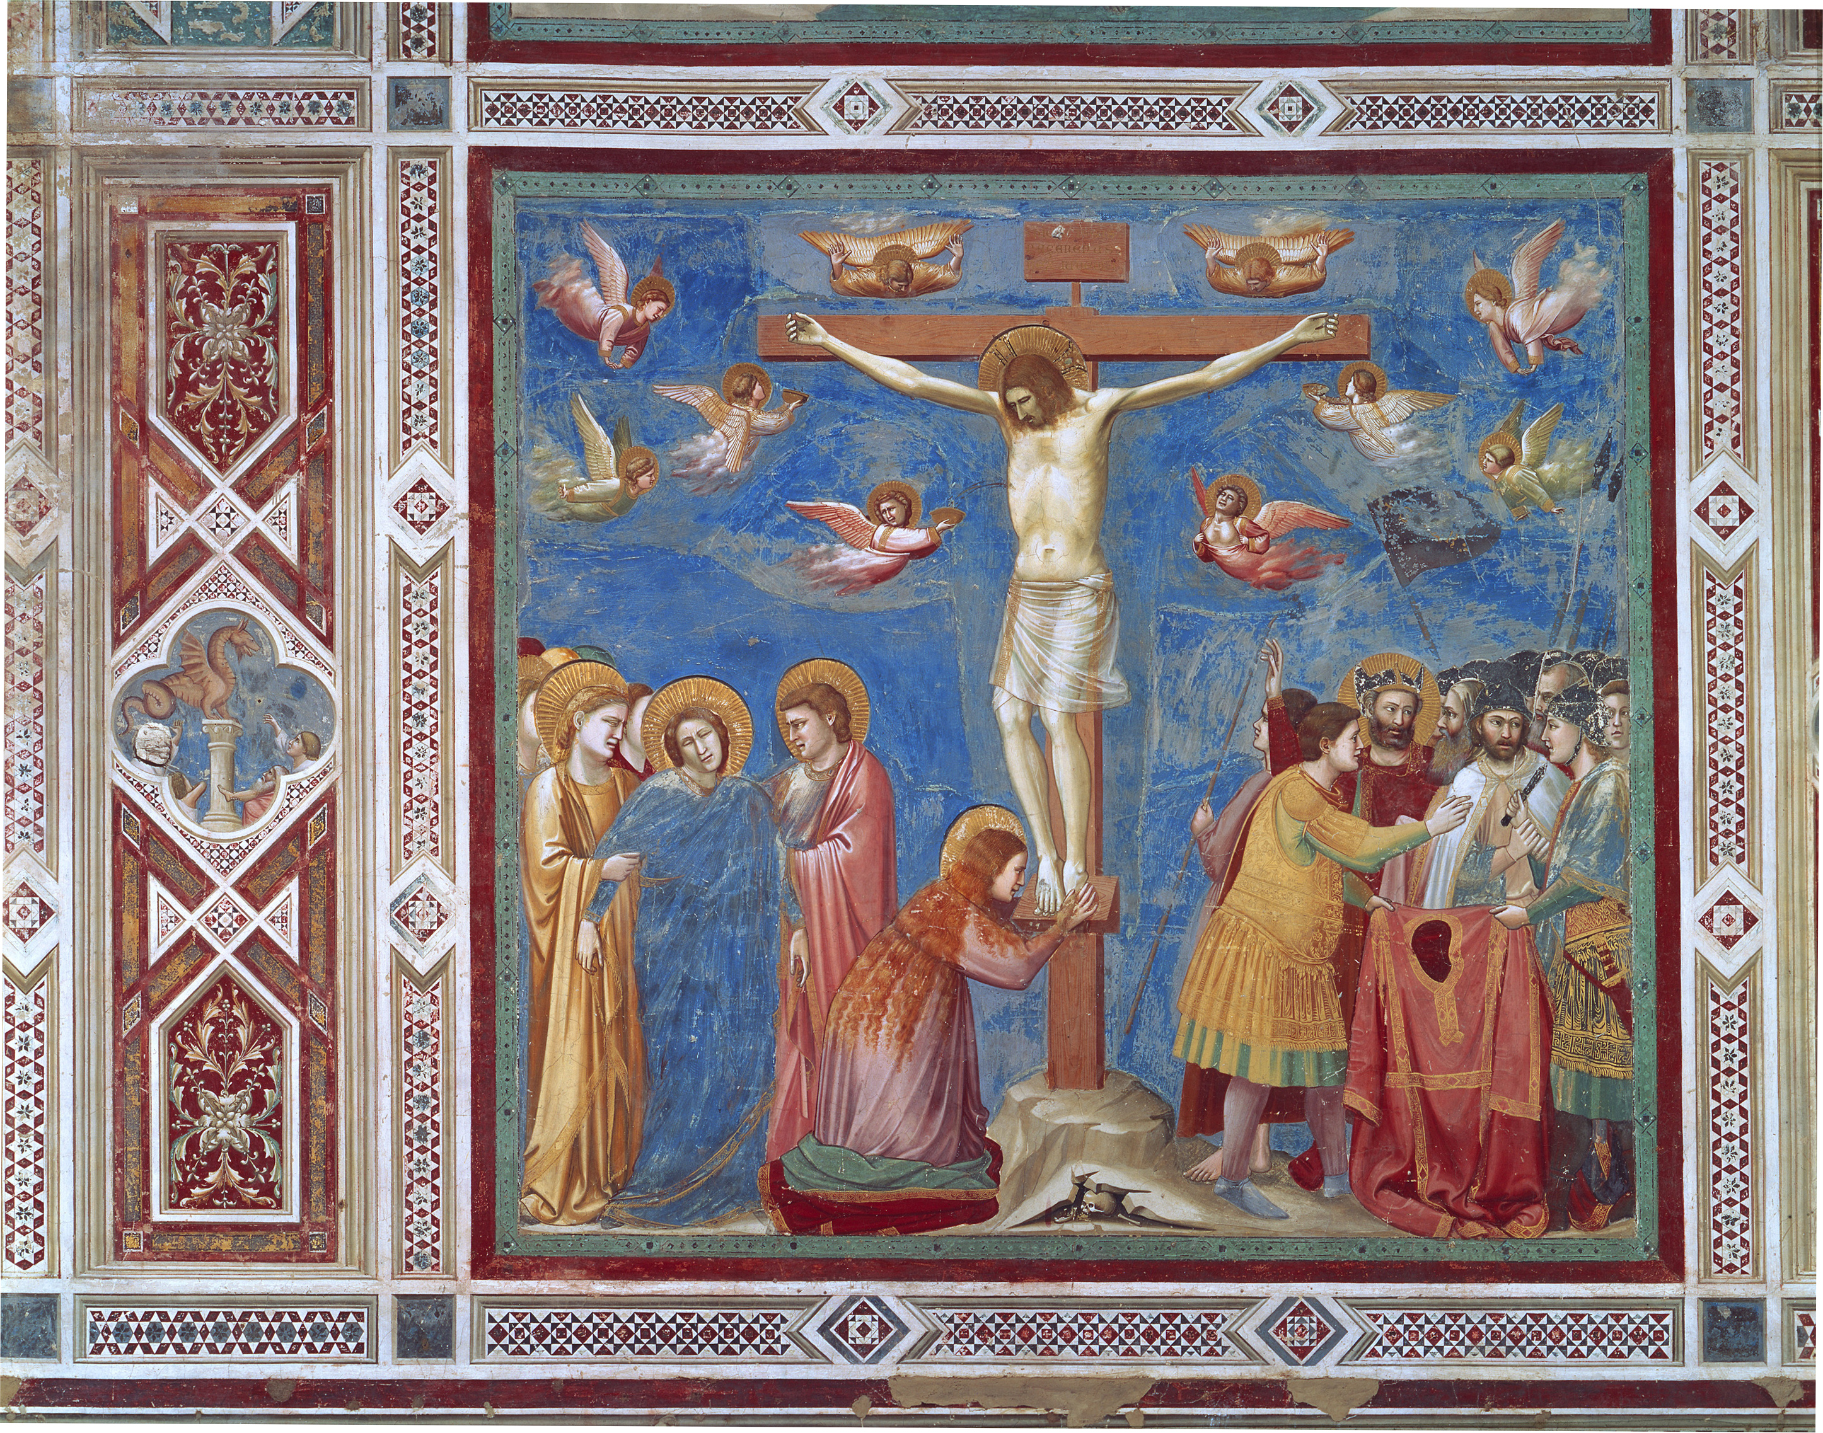
The Crucifixion, when Christ died on the cross

Slide 49
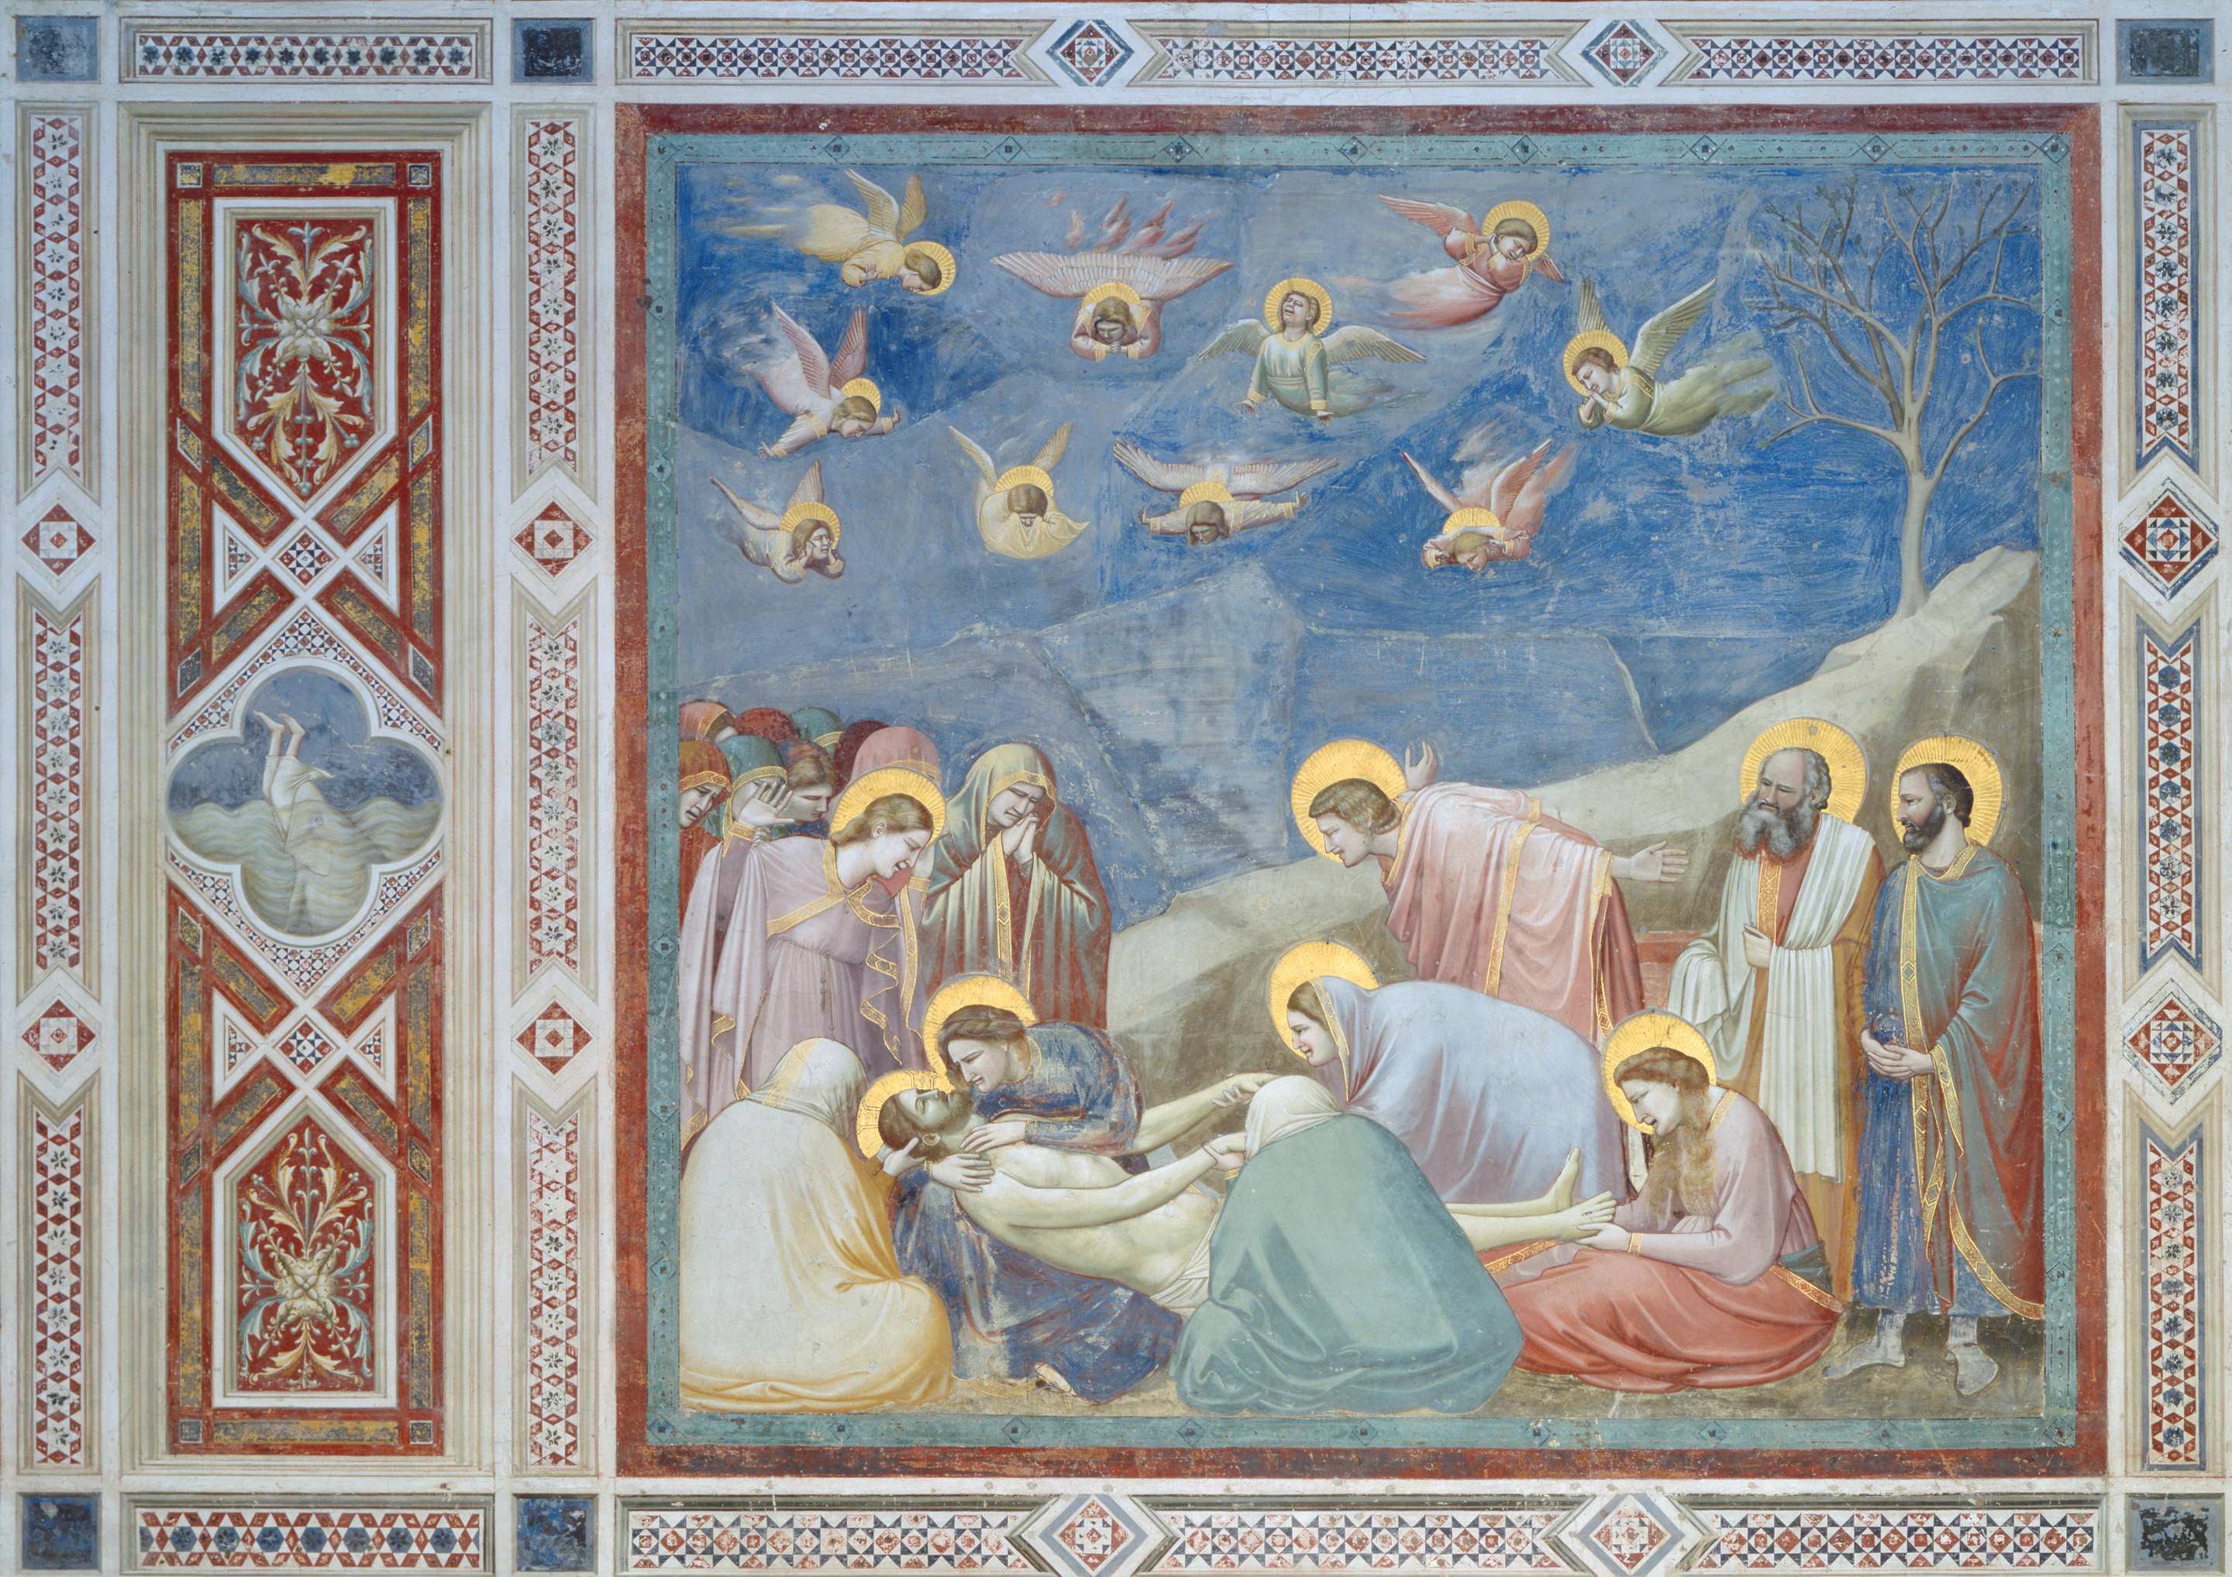
The Lamentation, when the apostles and Mary, Christ's mother, mourn for Christ

Slide 50
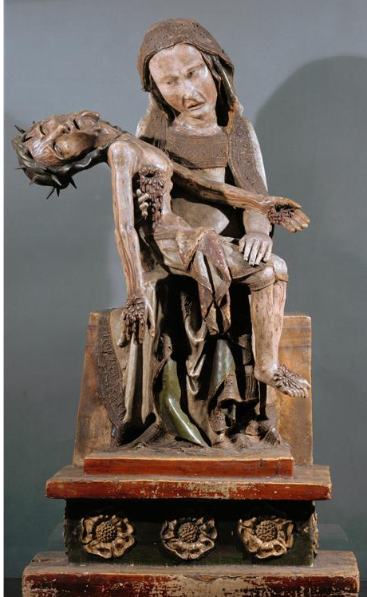
Virgin with the Dead Christ (Röttgen Pietà), from the Rhineland, Germany, ca. 1300–1325. Painted wood, 2’ 10 1/2” high. Rheinisches Landemuseum, Bonn.
Notes:
<number>

Slide 51
Shiva as Nataraja, ca. 1000. Bronze. Naltunai Ishvaram Temple, Punjai.
Notes:
<number>

