Slide 1
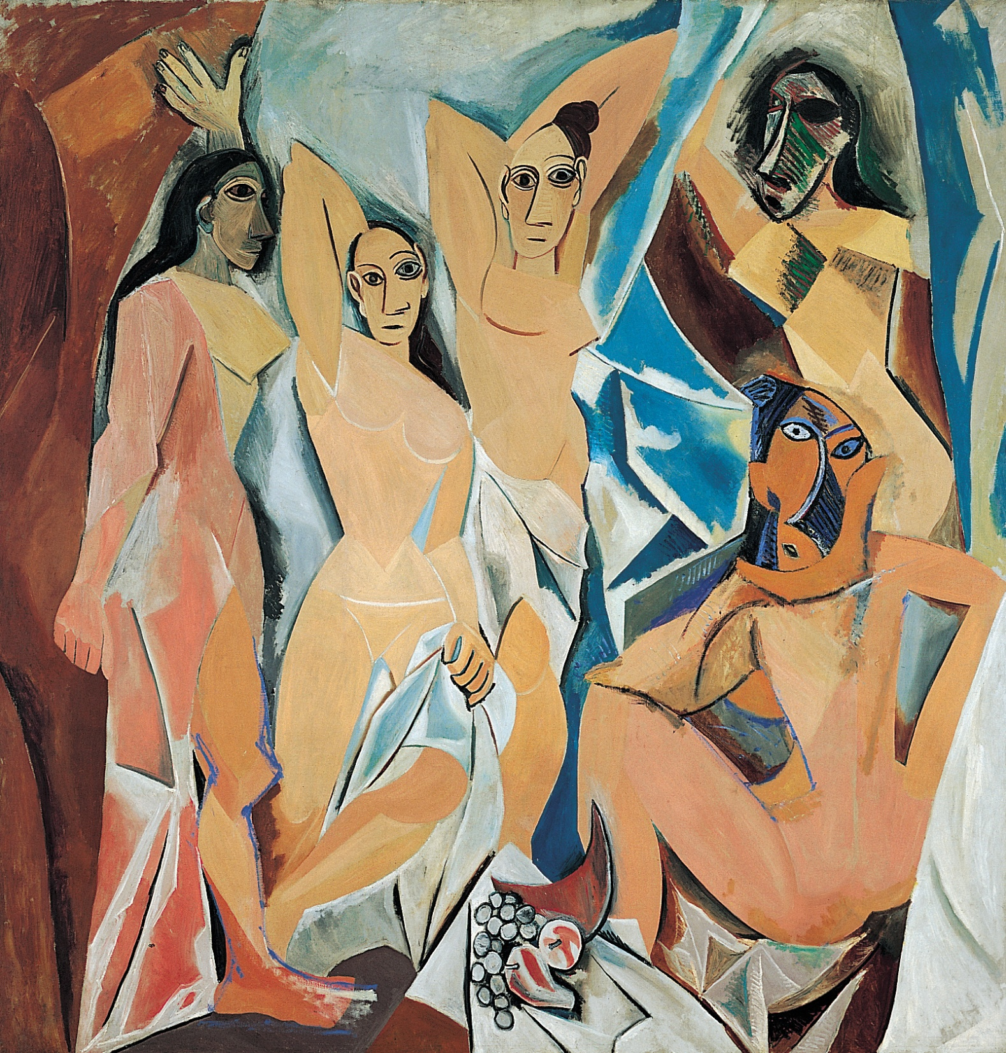
PABLO PICASSO, Les Demoiselles d’Avignon, 1907. Oil on canvas, 8’ x 7’ 8”. Museum of Modern Art, New York (acquired through the Lillie P. Bliss Bequest).
<number>
Notes:
<number>

Slide 2
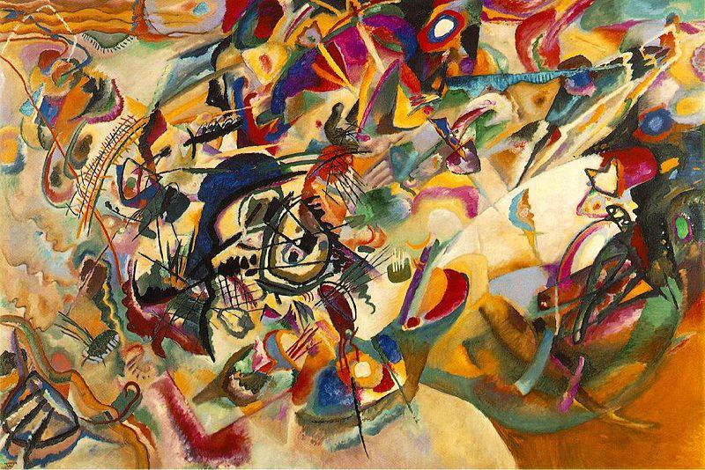
Wassily Kandinsky, Composition VII, 1913

Slide 3
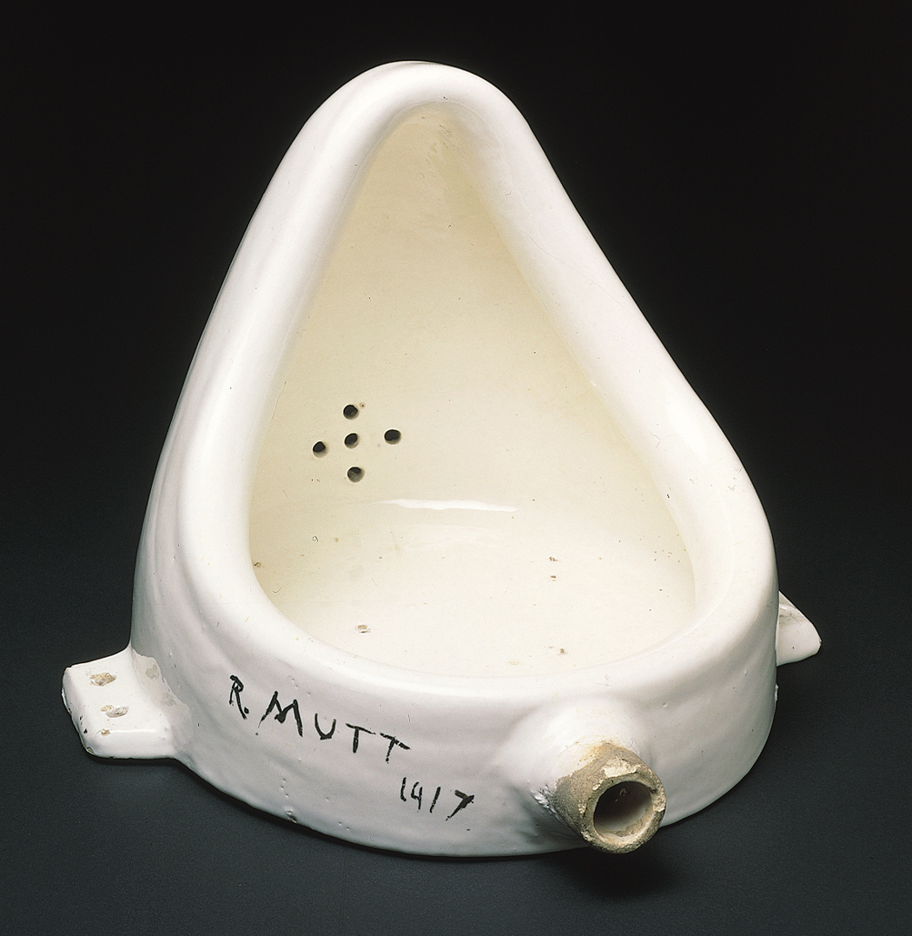
MARCEL DUCHAMP, Fountain, (second version), 1950 (original version produced 1917). Readymade glazed sanitary china with black paint, 1’ high. Philadelphia Museum of Art, Philadelphia.
Notes:
<number>

Slide 4
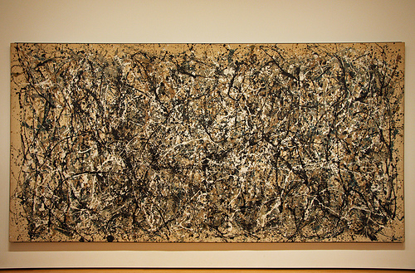
Jackson Pollock, One: Number 31, 1950

Slide 5
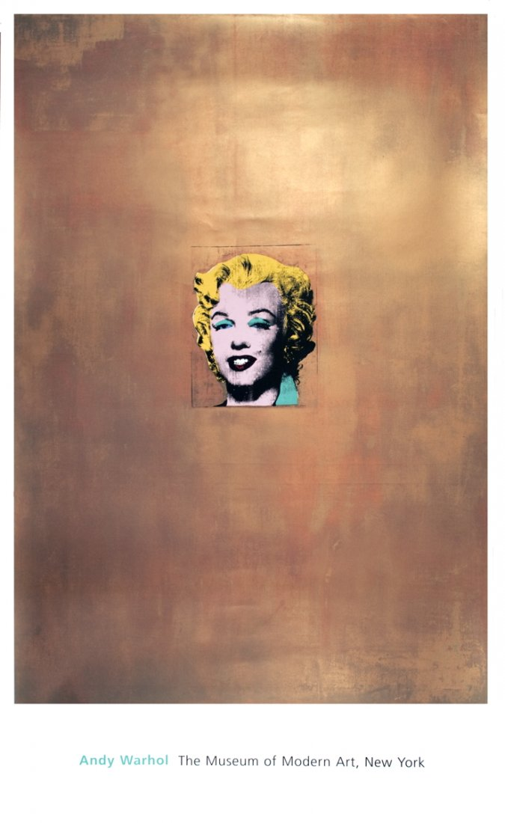
Andy Warhol, Gold Marilyn Monroe, 1962

Slide 6
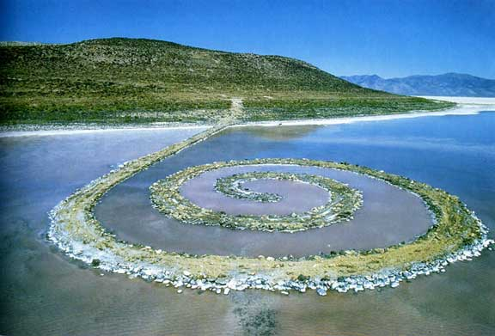
Robert Smithson, Spiral Jetty, 1970

Slide 7
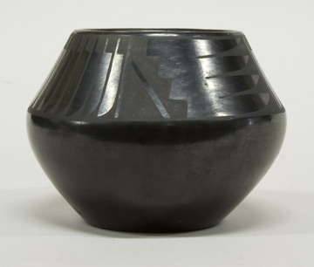
Maria Martinez, Black-on-Black Bowl with Geometric Motif, first half of the 20th Century

