Slide 1
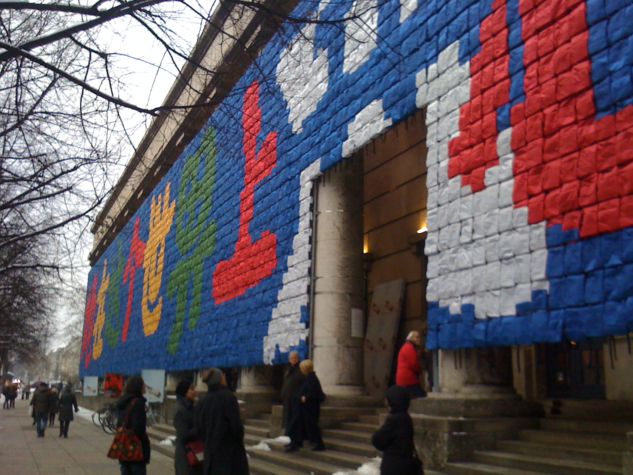
Ai Weiwei, Remembering, backpacks,
Haus der Kunst,* Munich, 2009

Slide 2
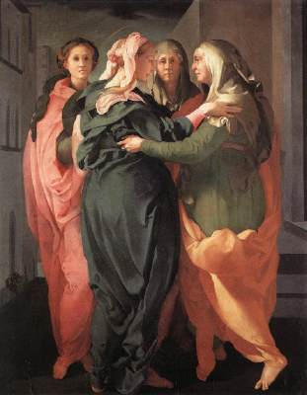
Bill Viola, The Greeting, Grace Cathedral 1995
Jacopo Pontormo, Visitation, 1528-29
Oil on wood, 202 x 156 cm
San Michele, Carmignano (Florence)

Slide 3
Kara Walker,"Slavery! Slavery! presenting a GRAND and LIFELIKE Panoramic Journey into Picturesque Southern Slavery or "Life at 'Ol' Virginny's Hole' (sketches from Plantation Life)" See the Peculiar Institutions as never before! All cut from black paper by the able hand of Kara Elizabeth Walker, an Emancipated Negress and leader in her Cause," 1997, Installation view, "no place (like home)," at the Walker Art Center, Minneapolis, Minnesota, 1997Cut paper and adhesive on wall, 12 x 85 feet, Collection of Eileen and Peter Norton, Santa Monica, California

Slide 4
Cindy Sherman Untitled Film Still #48, 1979, photograph, Collection of The Museum of Modern Art

Slide 5
Helen And Newton Harrison, Sierra Nevada, 2011 (installation view south gallery) aerial photograph, digital mapping, pastel, oil, and ink 42 feet long x variable width
In Sierra Nevada: An Adaptation, internationally-renowned environmental artists Helen Mayer Harrison and Newton Harrison propose a series of long-term ecological responses to recorded temperature increases in the Sierra Nevada, in collaboration with the Museum's Center for Art + Environment.Their proposals are in response to potential changes that threaten the elimination of beneficial plant species and the invasion of harmful ones. The Harrison’s ideas are presented conceptually in a 30-foot-long map of the mountain range, topographical sketches of its seventeen principal watersheds, and aerial photographs of sites in the Truckee and Yuba watersheds. Additionally, digital animations predict two various global warming scenarios revealing what will happen if nothing is done or if modest interventions are made, and conversely if landscapes are generated to serve cultural and natural needs.This exhibition represents early iterations of what will eventually be a fifty-year project.

Slide 6
Walton Ford, Falling Bough, 2002 Watercolor, gouache, ink and pencil on paper, 60 3/4 x 119 1/2 inches Private collection, Tennessee Courtesy Paul Kasmin Gallery, New York”

